Slide 1

Notes:
Welcome to this workshop on fixed income and bond portfolio management.
Generally, students don’t get excited about this topic. I hear that this asset class is boring and that you can’t make money with it. The negative image is even reflected in language. In French, for example, bonds are called «obligations» – obligations, not a word with positive connotations (maybe you change the point of view if you thank that your bond is someone else’s obligation). In German, bonds are called «Renten» which is the same word used for pension income – again not a dynamic image.
I would like to show you that negative images associated with bonds are unfounded. After all, there is a reason that nobody calls the guy «James Stock».

Slide 2
1
The Center of the World
2
Review of basic concepts
3
Managing interest rate risk
4
Inflation really matters
5
Managing credit risk
6
Managing global fixed-income portfolios
7
One more thing
Notes:
The material of this presentation was put together for a guest lecture at the University of Trondheim in 2016. Students are in MSc in Business program and are supposed to have a decent technical background in finance. They have seen discounting, bond valuation, duration, term structure, spot and forward rates.
The course is supposed to be something like a practical workshop. So, I show some real-life material and try to focus on how things are done. Still, as most of the students have not set foot in the financial industry, I keep the discussion on a relatively abstract level without going into too much practicalities. Be prepared for a hard ride: I’m going to throw lots of concepts and ideas at you.
After a brief intro, I start with a review of the basic concepts. This is standard material but presented in a slightly different (graphical) way. I then show how interest rate trades are formulated and put into practice. In section 4 we have a closer look at inflation and inflation-linked bonds. This topic is often neglected but it is crucial for understanding the nature of fixed income in a total asset allocation context. Credit is treated briefly in section 5. I will show how idiosyncratic and systemic credit risks can influence performance. In section 6 we study various questions related to global fixed income portfolios. These questions include fx hedging, global yield and duration. Finally, we round off the course with a brief chapter on risk management and performance attribution.

Slide 3
1
The center of the world
Notes:
Let’s jump right into the topic. To start, we put fixed income in the global context. We also set the stage for portfolio management.
After this section you should be able to
Understand the role of debt in the economy.
Appreciate the importance of the bond market.

Slide 4











A map to the center of the world
Institutional Investors
Governments
Corporates
Special Purpose Vehicles
People
with money
Ordinary people
Central Banks
Notes:
Warm-up exercises: place these terms in the graph
Wealth management
Institutional asset management
Open market operations
Repo facilities; TARGET II
Bond syndication
Securitization
Structuring
Mortgages
Pension fund account
Shadow banking
Bond auctions
Leverage
Financial Intermediaries
Student loans
Further stuff: check out the reports on shadow banking by the Financial Stability Board (www.fsb.org); they provide up-to-date information on the channels of credit creation. Fixed-income funds and securitisation are important shadow banks. The topic was prominent in the IMF Annual Meeting 2016 (you find interesting material in their October 2016 Global Financial Stability Report).

Slide 5
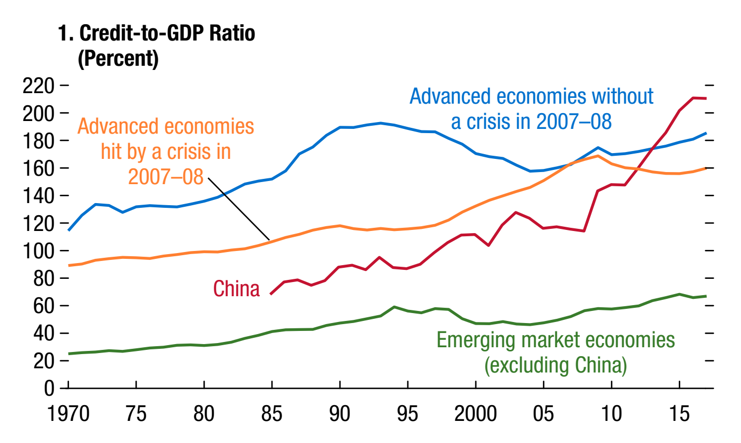
Debt is rising – good or bad?
Private sector (non-financial) debt / GDP
Source: IMF Global Financial Stability Report 4/2018
Notes:
As shown on the preceding slide, debt holds a pivot place in the economy. This slide shows private sector ex financials debt, i.e. the public debt of the central government and bank debt is excluded. What you see here is that debt has been on the rise for a long time.

Slide 6
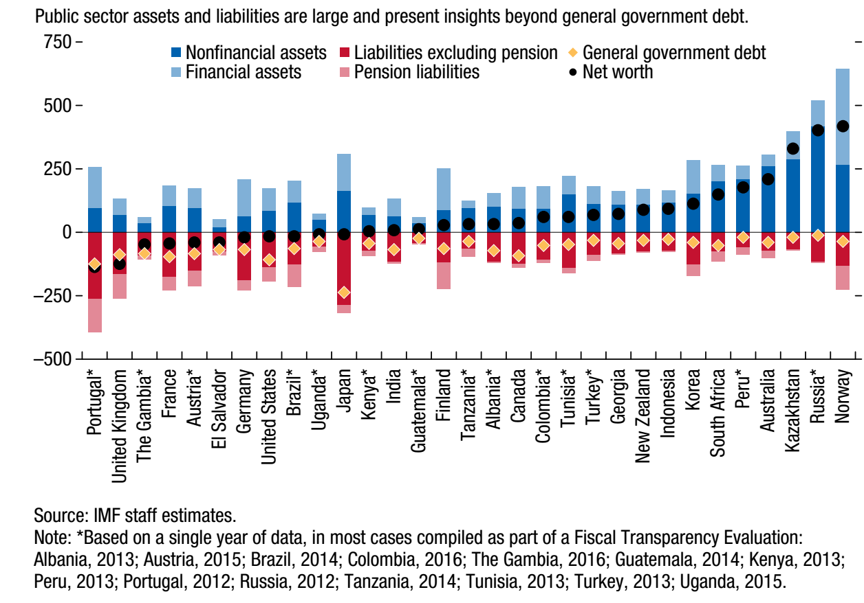
But debt is not the full picture
Source: IMF Fiscal Monitor 10/2018
Notes:
A high level of debt (be it private or public) tends to be a potential source of trouble. But the figure alone has always to be put in context with other financial data. Here you see the most recent analysis of the IMF that takes into account pension liabilities and nonfinancial assets.

Slide 7

How big is the bond market? Huge!
$ 77.8 trn
World GDP
<1 year
< $ 300 mio
∼ $ 60 trn
ILB
$ 48.8 trn
EMD + HY
Barcap Global Agg
$ 45.8 trn
$ 35.1 trn
MSCI World
NOK 7 trn
Notes:
Barcap Global Agg is the industry index. An «index» is the market portfolio and is used as the benchmark for active managers. All bonds meeting some eligibility criteria (amount outstanding, currency) are put together to a virtual portfolio; each bonds is held by the amount outstanding. So, the market value of the index represents the size of the market. The Barcap Global Agg includes all fixed-coupon bonds with remaining maturity > 1 year.
Almost 90% of the Barcap Global Agg is denominated in the three main currencies. These are the only broad and deep markets.
Government debt and quasi government debt (agencies, regions, cities, «supranationals») make up 2/3 of the Barcap Global Agg.
Global Agg is quite a bit larger than global stock market capitalisation and 60% of world GDP.
Securitized bonds (mainly US MBS) are almost as big as corporate bond market. Compare their total of USD 15trn to the size of shadow banking on the preceding slide.
Government Pension Fund Norway is NOK 7 trn / USD 0.9 trn.
Total bond market is larger than just Global Agg’. Sub-Investment Grade and Inflation-linked bonds add roughly 3 trn. On top of that, there are bonds with maturity below one year and smaller issues (private placements)

Slide 8
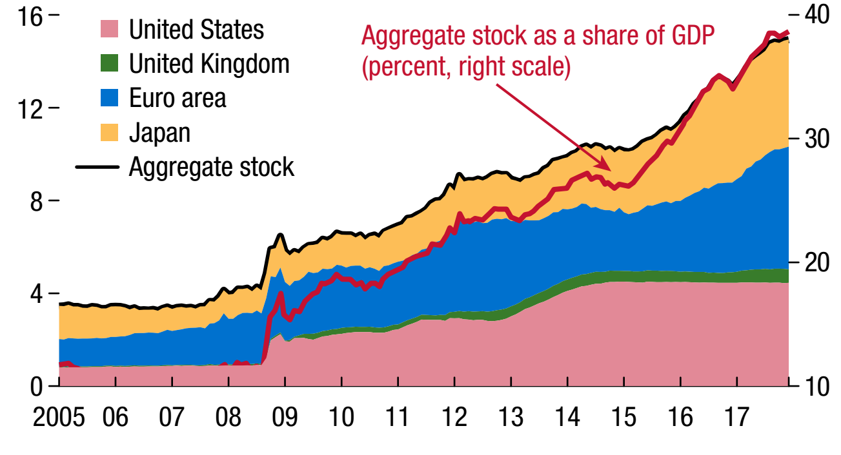
Central banks have become the main player
Central bank balance (USD trillion, left scale)
Source: IMF Global Financial Stability Report 4/2018
Notes:
More:
youtube «How the Economic Machine Works by Ray Dalio» - a simple and fun presentation of the mainstream theory of debt-bust cycles. Dalio is a highly successful hedge fund manager and is sometimes accused of running his company Bridgewater like a religious sect. He is also the inventor of the “all weather fund” concept.
Check out on the concept of «balance-sheet recession», a term phrased by Richard Koo. Koo is a famous economist at Nomura. He uses the concept to explain the low-growth/low-interest-rate environment of Japan. He believes that fiscal policy should be used to overcome the liquidity trap.
“Deleveraging? What Deleveraging”, Geneva Report on the World Economy #16. A 2014 study of by an illustrious panel of practitioners and academics.

Slide 9
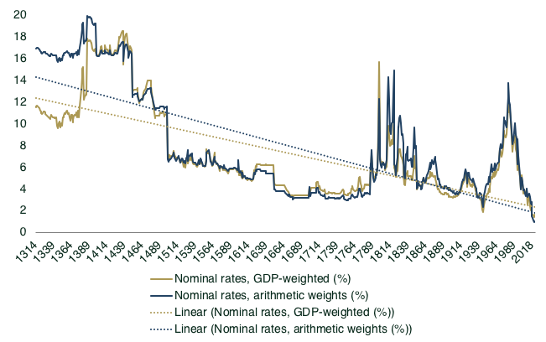
Welcome to the low-yield-environment
Notes:
We can’t talk about bond management without mentioning that we are in a very untypical environment – the low-yield-environment. Why is this the case?

Slide 10
2
Review of basic concepts
Notes:
This chapter presents the stuff you are already supposed to know in a slightly different way: graphs. We will move relatively quickly through valuation, duration, and forward rates.
After this section you should be able to
Apply discounting and compounding.
Price fixed-rate bonds.
Interprete various duration measures.
Understand forward rates and forward curves.

Slide 11
Cheat sheet
 | Annual | Semi-annual | Continuous
Compounding (PV → CF)
Discounting (CF → PV)
Discountfaktor (δ)
Used | Continental Europe | Anglo-Saxons, Japan | Quants
Notes:
The objective of this slide is not that you learn something. Rather I would like to wake up your memory and make you familiar with my notation. I use CF for cash flows – typically occurring on the time axis somewhere in the future. PV stands for present value which, obviously, is linked to the present. In my universe, PV is both the present value of an investment as well as cash today.
Fixed income investments are basically cash flows arranged on the time axis. In order to value them, you need to know these basic formula of finance. They describe the processes of Compounding and Discounting. Compounding moves current investments (PV = present value) to future cash flows (CF). Discounting translates future cash flows (CF) into present value (PV). Compounding and discounting can be done on an annual, semi-annual, quarterly, monthly, weekly, daily basis or even in continuous time. I will make heavy use of the last version. Important to keep in mind that the interest rate differs between the compounding conventions. 5% annually compounded grows slower than 5% continuously compounded. But you can always translate annual interest rates into continuous interest rates – and both grow exponentially.
Note the special role of the discount factor δ . Whatever the compounding convention: PV = δ *CF.

Slide 12

Compounding and Discounting
«Compound interest is the eighth wonder of the world!»
CF
Compounding
PV
Nominal
Discounting
Notes:
This is the first example of one my simple rates charts. Note that the y-axis is actually a log scale. This trick makes sure that the exponential growth of capital translates into a straight line. The slope of the line equals the interest rate used in compounding and discounting. As it is represented by a log scale, you have under continuous compounding log(CF) = log(PV) +yT.

Slide 13
From Discounting to Valuation
t
Notes:
Typically, a bond consists of more than one cash flow – a cash flow stream. Valuing cash flow streams is straightforward. As the cash flow stream is nothing than a package of cash flows, the value of the package is simply the sum of the value of all cash flows.
What can be added, can also be split again. That’s how strips were born: by separating coupon from capital payments.

Slide 14

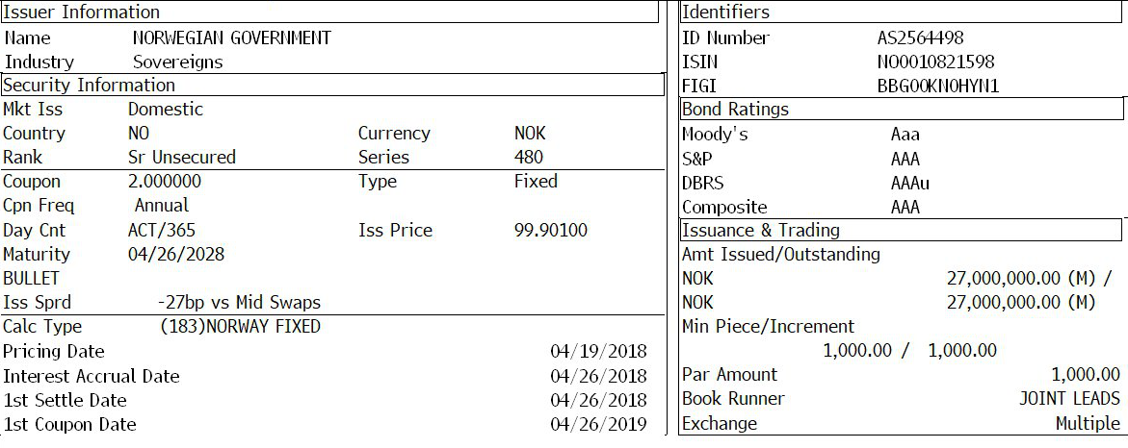
Real Life Example
Notes:
[Discussion: What do you see in this Bloomberg Screen?]

Slide 15
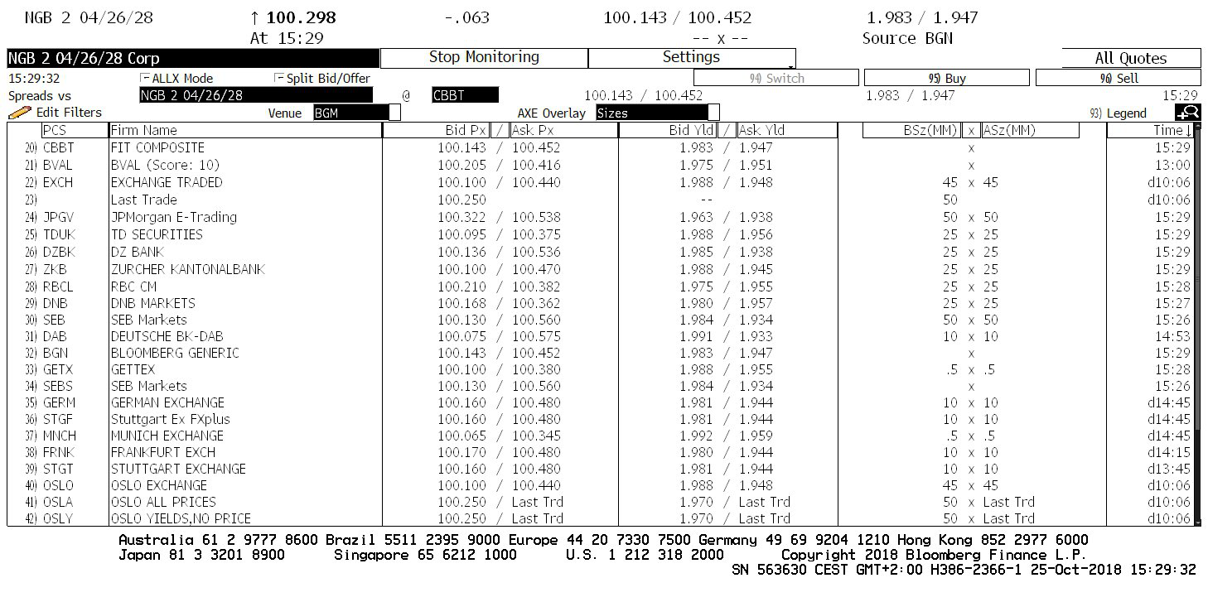
This is how such a bond trades

Slide 16
How does valuation work?
CF date | τ | δ | CF | PV
26.04.2019 | 0.49 | 0.990526 | 2 | 1.98
27.04.2020 | 1.49 | 0.971433 | 2 | 1.94
26.04.2021 | 2.49 | 0.952810 | 2 | 1.91
26.04.2022 | 3.49 | 0.934494 | 2 | 1.87
26.04.2023 | 4.49 | 0.916530 | 2 | 1.83
26.04.2024 | 5.49 | 0.898911 | 2 | 1.80
28.04.2025 | 6.50 | 0.881537 | 2 | 1.76
27.04.2026 | 7.49 | 0.864683 | 2 | 1.73
26.04.2027 | 8.49 | 0.848061 | 2 | 1.70
26.04.2028 | 9.49 | 0.831759 | 102 | 84.84
 |  |  |  | 101.36
Notes:
Now, let’s walk through the real-life example above and try to validate the valuation formula. For simplicity, we set the interest rate at 2%. I prepared two weeks ago with settlement 29 October.
Here are the steps:
Determine the cash flow dates. The bond pays coupons each 26 April until 2026 (except on weekends). We have 179 days between 29-Oct-2018 and 26-Apr-2019. Day Count convention is act/365, so we have 179/365 = 0.4904 years. Add years until 2028
Calculate the discount rate with 1/(1+1.96%)^t
Determine the cash flows. The bonds pays coupon 2 every year. 2028, it will pay back capital 100.
Discount each cash flow to present value by multiplying CF with the discount rate
Sum up, this yields 101.36
Why is this not the price? Well, it is! It is the dirty price. The difference is explained by accrued interest.

Slide 17
Clean is the new dirty
t
t
Notes:
The use of accrued interest is annoying. The effective price of a bond, meaning the price you actually need to pay, is the dirty price. This is also the price we obtain when we value the cash flow stream of the bond. Per se, there is nothing dirty about this. However, as coupons drop out of the bonds (the future cash flow stream), the price drops once a coupon period. Now, some people did not like the behaviour of the price. They introduced a market convention that «cleans» the price of the ups and downs. For this, they introduce «accrued interest» (IA). IA is the fraction of the coupon period remaining until the next coupon times the coupon. IA accrues linearly – contrary to the actual price move over time. Deducing accrued interest from the dirty price gives you the clean price.
Keep in mind: only the dirty price is relevant. The clean price always needs to be adjusted by accrued interest to make any sense. In this sense the clean price is actually «dirty».

Slide 18
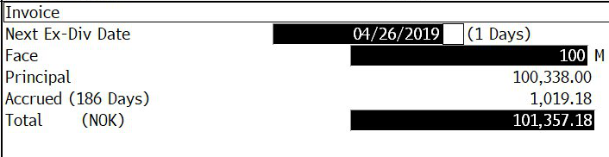
Invoice value is the dirty price
Notes:
So we have 186 days since 26-Apr-2018. Hence, accrued interest is 2*186/365 = 1.01918.

Slide 19
Macaulay Duration = weighted average time to cash flow
t
Notes:
I expect you to know the formula of the Macaulay duration. The unit of DMacaulay is years, it measures time. More specifically, it measures the weighted average time (in years) to the cash flows of the bond. It’s a weighted average because each cash flow is weighted by it’s share of the dirty price of the bond.
Macaulay duration is a rather useless concept….

Slide 20
Or: Macaulay duration = time to absorb a shock
Macaulay Duration
Capital
170
160
150
140
130
120
Δy=-1%
110
100
Δy=1%
90
0
1
2
3
4
5
6
7
8
9
10
Notes:
… except for one interesting point. On this slide I do a simple thought experiment: Buy a 5% par bond with 10year life. Suppose, that just a millisecond after you bought the bond, interest rates move. What happens?
Answer
Immediate effect: When interest rates rise (fall), bond prices fall (rise). Here, the blue (black) line
As the yield has risen (fallen), capital grows faster (slower)
All scenarios intersect at one point. This happens to be the Macaulay duration.

Slide 21
Duration works like a lever
t
Notes:
So far we have viewed duration as a time measure. More important is the risk measure aspect. The basic principle is shown in the graph: When rates rise, the slope of the compounding / discounting curve gets steeper. In a bond, CV is fixed, so a steeper discounting curve means a lower PV. The longer the lever, the stronger the effect. In fact, if y is the slope, the change in y multiplied by the length of the lever (which is τ) yields the difference in PV on the chart. Now, do not forget that this is a log scale, so we are talking about changes in the log of PV which is the percentage change in PV. For a zero bond this means that τ is a risk measure. It tells you how sensitive is your price to a change in yield. For a zero bond, τ is the (modified) duration.

Slide 22
Duration is the derivative of the price with respect to the yield
Derivative of PM wrt y. Meaning: by how much (in absolute terms) does PV of one cash flow rise when y rises by one unit?
Sum this up for all CF. Meaning: by how much (in absolute terms) does P of the bond rise when y rises by one unit?
Mulitply by -1 (to make positive) and divide by P (to make it a relative change). Meaning: By how much (in %) does P fall when y rises by one unit.
Notes:
Modified duration answers a simple question: how much does the price of a bond change, if interest rates move a bit. In order to answer this question we use simple maths, i.e. derivatives. You remember the discounting formula at the beginning of this chapter. In the annual version this is PV = CF / (1+y)^{τ} . Now, take the derivative of PV with respect to y and you will end up with the first equation. It shows by how much (in currency units) PV rises for a unit change in yield. This is a negative value; i.e. when the change in yield is positive, the change in PV is negative and vice versa.
The second equation simply takes the sum. Instead of showing how much the price of the cash flow changes it shows how much the price of the bond changes.
The third and final equation does two things: (1) Multiply by -1 to make the value positive. There is no fundamental reason to do this except that market standard has that duration needs to be a positive measure. The negative value is not forgotten. We will show next page that you undo the multiplication whenever you estimate price impacts. (2) The expression is divided by P (which is the dirty Price P_{D}!!!). This ensures that the sensitivity is expressed in terms of relative change (or percentage change). Hence, duration does not tell you a change in monetary units, but a change in percent. You can also see this as a normalization. Duration can be applied to bonds but also to portfolios of bonds. If you normalize it, the value becomes comparable across portfolios of different size.

Slide 23
Duration has a (negative) mulitplier effect
⇒
Notes:
On this slide, I turn the equation around. By simply re-arranging, I obtain the upper expression. First note that the multiplication by -1 on the preceding page is back here (had we not multiplied by -1, Duration would be negative and we would not need to multiply by -1 here).
I also wrote down a second expression which differs slightly. Instead of dy, we now have Δy. dy stands for an indefinitesimaly small change: how much does P change if y moves by a very very very bit. In practice, if y changes only by a very very very small bit, we don’t care. But we want to know, for example, how much is the impact of a 5bp change in yield. 5bp is a bit more than an infinitesimal small change. Unfortunately, as the equation was derived by a derivative of the pricing formula, the equality breaks down. It becomes an approximation. Fortunately, the approximation is ok-ish for reasonably small changes in y.

Slide 24
The convexity measure can improve the approximation
140
130
120
110
100
90
80
70
Convexity effect
60
0.00%
1.00%
2.00%
3.00%
4.00%
5.00%
6.00%
7.00%
8.00%
y₀
y₁
Notes:
Using duration to approximate the (relative) change in the bond price boils down to approximating the price of the bond by a linear function. The dark blue line shows the true pricing function. The linear approximation by the duration formula is shown in turquoise. The function goes through the initial price and yield, P₀ and y₀. As an example, assume that the yield increases to y1. The linear duration function then shows an approximate new price. However, if we price the bond with the true pricing function, we get a higher price. The difference between the approximation and the true price is due to the convexity effect.
You could improve your approximation using the convexity formula given on the slide. This convexity adjustment removes a large junk of the error. For the more mathematically inclined, this is a second-order Taylor approximation to the problem. Still, it remains an approximation and it would be easier to simply use the true formula. In practice, convexity matters when you use bonds with embedded options or mortgage-backed securities.

Slide 25
Definitions
Zero (z_{τ}) Interest rate used for discounting single cash flow. Basis for valuing any type of cash flow stream.
Zero curve Function mapping tenor to zero rate.
Yield (y) Internal rate of return measure (IRR). For a bond, the yield is interest rate that makes sure that the price obtained in the pricing formula is the actual price.
Yield curve Function mapping the maturity of a set of bonds to their yields-
Par curve (p_{τ}) Function mapping the maturity of bond that trade at par (100) to their yields. For these bonds, the coupon rate is identical to their yields
Notes:
So far, we have used yield and interest rate as loose concepts. Implicitly we have assumed no relationship between interest rate and tenor. This implicit assumption is not in line with reality. Each point on the timeline has a specific interest rate, i.e. there is a functional relationship between tenor and yield. For the following discussions, you will need to know the definitions on this slide.

Slide 26
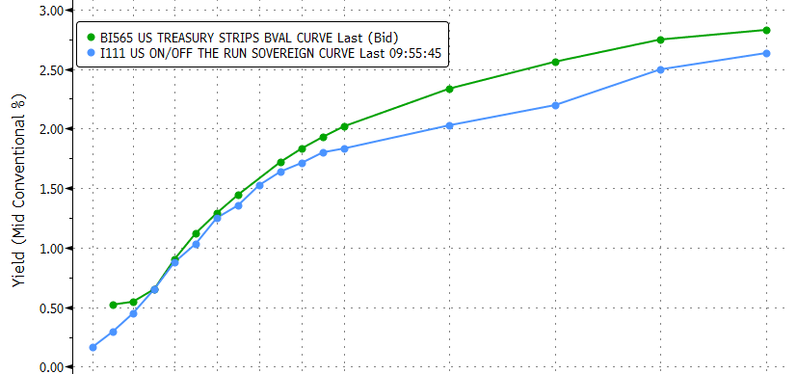
Zero-Curves are directly observable in the strip curve
US Treasury Strips
US Treasury Bonds
Notes:
Typically, you will not see zero rates published in the newspaper. However, if you have access to financial information systems, you can display the strip curve.
Treasury strips are single-cash flow fixed income instruments (zero-bonds because they have a coupon rate of zero). Originally they were created by physically cutting off the coupons from treasury bonds. Today, the major government bond markets sell strips. In practice, you will rarely buy them. Still, they are important because the zero curve is the basis for valuing any type of fixed income instrument.

Slide 27
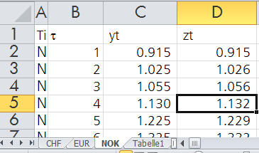
If there is no strip market, you need to calculate the zeros
Bootstrap
{=((
(1+C5%)/
(1-SUM(C5%/(1+D$2:$D4%)^B$2:$B4))
)^(1/B5)-1
)*100}
Fit a smart function (NS, NSS)
Fit an agnostic function
Notes:
In many markets, there are no strips. In order to get the zero rates, you will then need to calculate zeros. In practice there are three main methods:
1. The most simple one is the bootstrap. This is an iterative process starting at the first tenor and then moving step by step one period up.
τ=1: only one CF → z₁=y₁
τ=2: Strip off the value of the first coupons from the bond. The coupon has a known coupon rate. It occurs in τ=1. So, you get an adjusted price P* = P – c/(1+z₁). You then find z₂ such that CF₂ / (1+z₂)² = P*.
τ>2: As with τ=2, but now you have to strip out more than one coupon to get P*. On the slide you see the corresponding formula in MS Excel. On the fourth line, there is a sum. In the sum take all coupons (which are the par yields) and discount them with the corresponding z rates. I then take the n-th root of the ratio and subtract 1 in order to get a zero rate.
Bootstrapping works fine on a complete set of bonds {y₁, y₂, … y_{n}}. They should mature in regular intervals, indealy in 1, 2, 3 etc years. You may already guess that your rarely have this luxury. The only exception are swaps. Up to 10 years, most markets have swaps satisfying the conditions for bootstrapping.
If you can’t bootstrap, you have to fit the curve to your set of bonds, using one of the following two techniques.
2. You can specify a spot rate based on an financial economics model (a smart function). Most known are the specifications by Nelson/Siegel (1987, NS) and the extension by Svensson (1994, NSS). The formula on the slide shows NSS. I have rewritten the NSS formula to be in line with our notation; NS is simply NSS without the last term. Fitting NSS contains 5 parameters, so you need at least 6 bonds. Price each bond with the formula with some starting value for the parameters. This will yield a vector of errors. Then play around with the parameters until the errors are minimized. NSS and NS are smart because they build on a specification of the forward rates and therefore satisfy some reasonable constraints. You will find MS Excel solutions for NSS/NS on youtube.
3. Instead of NSS or NS you can simply fit it to any type of specification. The example on the slide show piecewise polynomials. This method is called splines.

Slide 28
From zeros to yield
t
y, z_{t}
Zeros
Yield
t
Notes:
In this chart you see the link from zeros to yields:
Fixed Coupon bond is a cash flow stream (a package of cash flows)
Each cash flow CFτ can be valued by the corresponding zero rate zτ to obtain PVτ. The sum of all PV is the dirty price P.
Above we’ve seen that instead of valuing each cash flow with the corresponding z rate, we can also use the yield y for all cash flows. Note that y has no subscript for τ.
y is the value that ensures that the two methods yield the same price P.
There is no closed-form formula for y! y has to be determined iteratively by a computer (e.g. via the Newton-Algorithm)

Slide 29
Four shades of duration
 | Weighted average time to cash flow.
 | Sensitivity of bond price to yield.
 | Sensitivity of bond price to parallel shift in zero curve.
 | Quasi-modified duration with continuous discounting.
Notes:
Now we have the ingredients for the four most used duration formula.
If at some stage in the future, you want to do the CFA exam, you will need to read the textbook by Fabozzi. Fabozzi will tell you that all these duration measures are useless and that the only meaningful duration concept is that of effective duration. He works with a duration formula that finds the slope by shocking the price of the bond by a small amount up and down (P(y₀-d)-P(y₀-d))/2d. Fabozzi is right and wrong. He is right in the sense that the duration measure cannot always be calculated analytically. If you have bonds with embedded options, you will need to find duration the way Fabozzi does. However, he is also wrong because with a normal bond, we have used the derivative to get the modified duration. Taking a derivative is nothing else than letting d go towards zero (remember: infinitesimally small). Most importantly, if you understanding the derviation of modified duration, you understand the impact of the tenor on the interest-rate sensitivity of your bond.

Slide 30
Zero (spot) rates can be interpreted as slopes
Slope = z_{t}
t
Notes:
On this slide you see an alternative representation of the zero curve. It uses the principles of the rates charts introduced earlier. On each point on the time line you see the CF you would get for an initial investment of PV. As we’ve seen before, the slope between PV and each CFτ is the interest rate. Now we have become more specific: the slope represents zτ. As you can see, the longer the tenor, the higher zτ, as represented by increasing slopes (which is not the same as increasing CFτ). Empirically, this is a typical upward-sloping yield curve.

Slide 31
Forward rates are also slopes
t
Notes:
This is the same slide again. But this time, we do something new: forwards.
First have a look at the first two years. If you only have zero bonds, you can invest your money in a 1- or 2-year zero bonds. But if you have forwards you can do something new: you can invest your money in a 1-year zero bond, and then go do a forward that gives you the forward rate of interest from year 1 to 2. I describe this as f_{1,2}. As you have learned, f_{1,2} needs to be at a level that this new possible strategy yields the same result has buying a 2-year zero. Why? – Because otherwise, you could arbitrage the two investments! In the graph that means that the slope between CF₁ and CF₂ (which is f_{1,2}) will make sure the paths meet exactly at CF₂. This logic applies to all other forwards as well.
Taking the perspective of a long zero bond with tenor τ, we can graphically see that if we start from 0 and go through all the forwards up to τ we end up at the same point as zτ times τ. So every spot rate zτ is nothing else than the sum of the forward rates leading to τ, divided by τ. This, of course, is the average of the forward rates. In continuous time, the spot rate is the integral of the instantaneous forward rates up to τ, divided by τ. Again, this is the average.

Slide 32
Forward curves can be read off spot curves
t
t
Notes:
Before, we have derived the 1-year forward, starting in 1, 2, 3 etc years. Here we do something different. Again we start with our rates chart. The slope between PV and each CFτ represents the corresponding zτ. In the lower panel, this is represented as a spot curve, i.e. each tenor maps into a corresponding zτ - the usual way of presenting yield curves.
We can now move on to see how this spot curve is expected to look like in one year. Before, we have shown that non-arbitrage requires the forward from τ=1 to τ=2, f_{1,2}, can be read off the graph as the slope between CF₁ and CF₂. The same holds true for f_{1,3} , which is simpy the slope between CF₁ and CF₃ . And so forth. Consequently, the can map all f_{1,τ} to the corresponding τ. This gives us the forward curve.
For the moment, we can interprete the forward curve as the market expectation for the spot curve – more detail to follow.

Slide 33
3
Managing interest rates
Notes:
We start with a short intro to the asset management industry. From this, I give you a run-down on how people run interest rate positions.
After this section you should be able to
Draw investment conclusions from expected curve movements.
Put into context active duration strategies.
Understand and apply the concept of rolling yields.
Implement curve trades using futures and swaps.

Slide 34
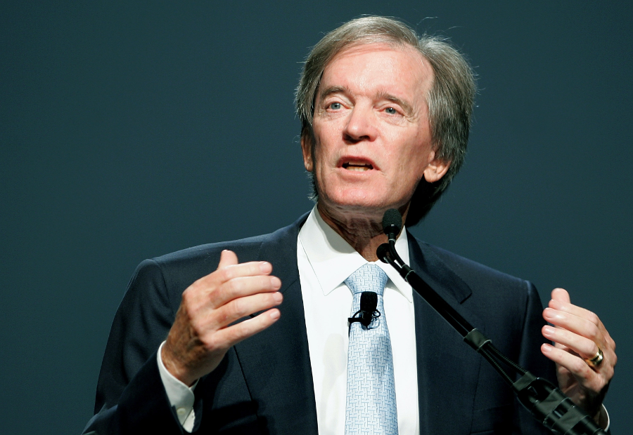
Want to learn about bond management?
Bill H. Gross
Founder and CIO of PIMCO
2005-2014: earned more than 1 Mio $ ….
…. per day!
Notes:
This slide appeals to your extrinsic motivation.

Slide 35
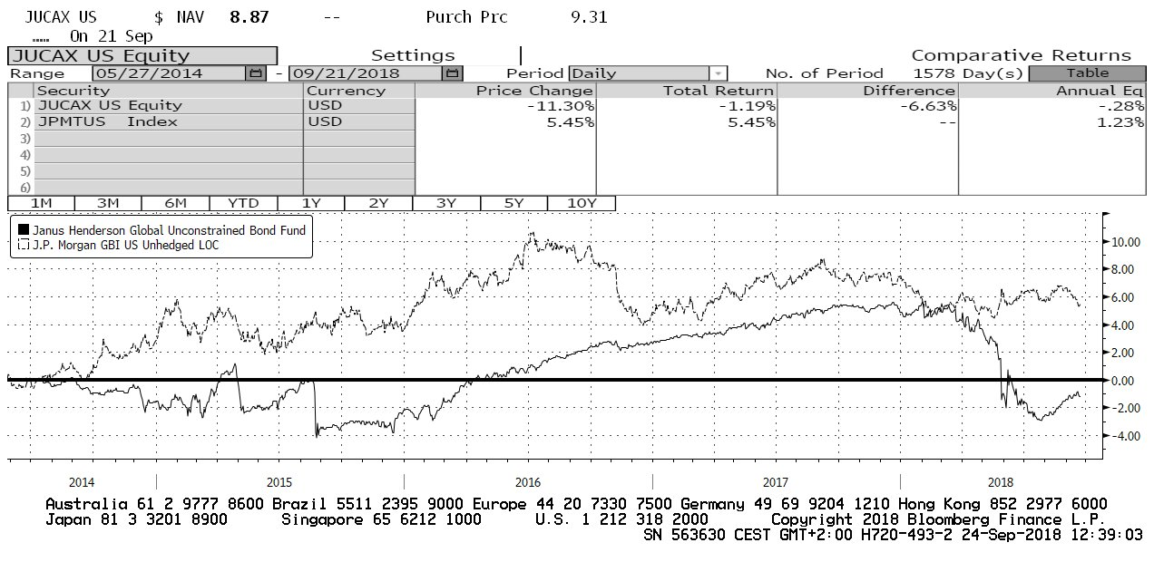
He’s not even a great portfolio manager …
US Treasury benchmark
Bill Gross’ new fund

Slide 36
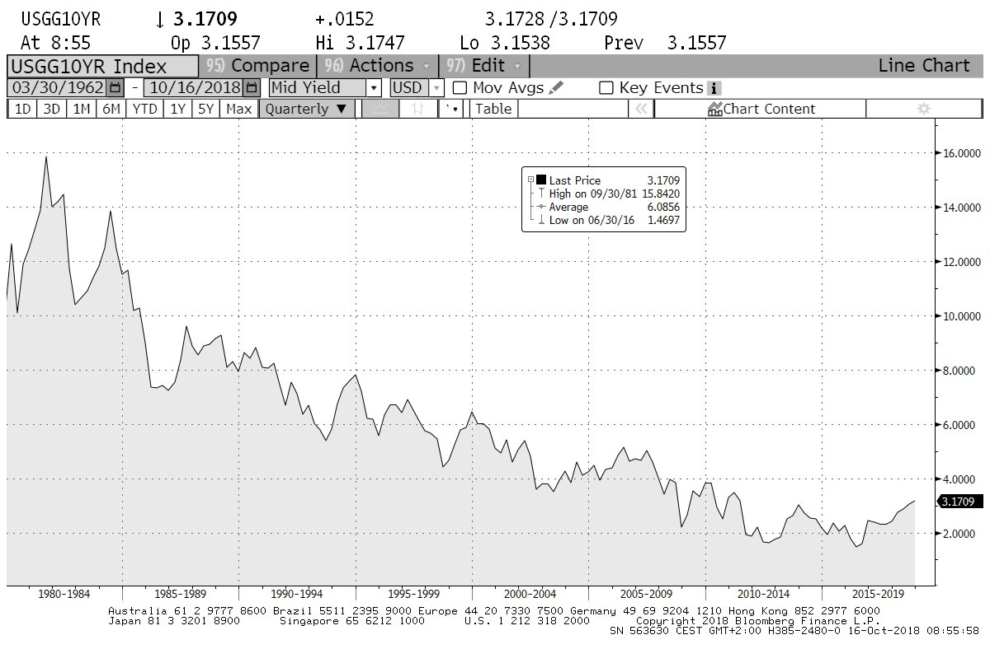
… but was riding a good wave.
10-year Treasury yield

Slide 37
If forwards are true, duration management is useless
t
0
1
Notes:
Active interest rate management means that you position your cash flows on the time axis. Ideally, you would like your cash flows to be put on those maturities with the highest expected return. This slide shows that for determining expected returns, you need to compare your expectations with the forwards (and not with the current yield curve). To understand the issue, look at the current yield curve. This is a slide you now have seen several times. In this chart, I have highlighted the one-year interest rate as well as the 1-year forward curve. Again, the bars in this chart (the CFs) can be thought of as zero bonds which all have an identical value of PV. You can think of them as alternative investment opportunities for a capital of PV₀.
Now, move mentally one year forward and assume that at this future date, the new spot curve matches exactly today’s 1-year forward curve. What would be the value of the different investment opportunities? It’s simply PV₁! Each cash flow can be discounted by the new spot rate (the previous forward rate). This means that the value of each investment opportunity has grown from PV₀ to PV₁. The performance of each bond is exactly the original one-year spot rate. Put differently, if the forward become true, it does not matter where you put your money. This principle is sometimes called «forward equivalence».
This is an important insight for active interest rate management. Consequences:
For interest rate bets, the relevant question is not the anticipated deviation from the current yield curve but the deviation from the current forward curve.
The importance of the distinction increases with the holding period.
If you interpret forward curves as the market consensus, your focus has to be on non-consensus views.

Slide 38
What does management of bond portfolios mean?
Wealth Management
Asset Management
Get exposure to the asset class in a total portfolio context (direct or pooled)
Mental accounting: bonds treated as the safe core of the portfolio
Tax optimization: bonds below par; withholding tax management
Suitability is key
Clients get mad at you when rates rise
Benchmark-oriented, focus on high information ratio
Segmented; more recently also focus on absolute return type strategies
Flexibility in the use of instruments
Transparency and liquidity are key
Clients get mad at you when you underperform your peers
Notes:
Before we take off we should ask ourselves, what we actually mean with bond portfolio management. There are basically two settings. The first relates to wealth management in the wide sense. This is the world of client advisors, private bankers, family offices, even roboadvisors. For them, bonds are part of the big picture. Bond management in this context means using fixed income instrument in the total context. They ask questions like: How big should the allocation to bonds be? What segments should we invest in? What should be the strategic duration of my portfolio? The fiduciary duty of the wealth managers forces them to look at bonds in a holistic way, including questions of suitability and the total costs post tax.
The second relates to asset management. This is an institutional setup. Bond managers in this industry only manage a slice of the portfolio with the explicit objective of adding value. Adding value is measured against a benchmark index. The bond manager is supposed to beat the index by taking active investment decisions. Active decisions are over- and underweights compared to the index portfolio. The challenge is to beat the market by more than the difference between the active fee minus the fee on a comparable index fund. Unfortunately, the sum of all market participants is the market itself. Hence, in aggregate, the asset management industry’s outperformance tends to be zero. You can only beat the market, if you do something better than the typical manager.

Slide 39
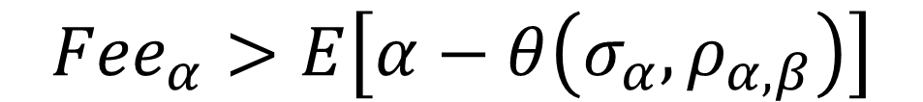
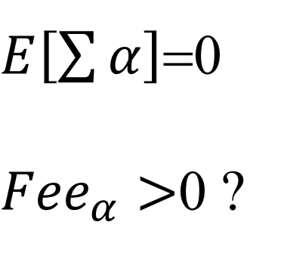
Why would anybody pay for active management?
$${Fee}_{α}>E\left[α−θ\left(σ_{α},ρ_{α,β}\right)\right]$$
$E\left[\sum{α}\right]$=0
${Fee}_{α}>$0 ?
Notes:
Both, wealth management and asset management, claim to add value by active investment decisions. The sales pitch sounds roughly like this: «We are great expertes and understand how the market works. Our cristal ball [smart fundamental analysis, relative value plays, chart technical analysis, a complicated econometric model or some fancy big data engine] allows us to anticipate the market, sell high and buy low. So, we systematically outperform a dart-throwing monkey – even on a risk-adjusted basis. Given this alpha, our fee is a bargain!»
In realîty, if we take all asset and wealth managers together, we basically end with the total market. The total market will never outperform the total market. So, on aggregate, the claim of wealth and asset managers cannot hold. Why then, are people willing to pay extra for active management?

Slide 40

How folks play the duration game
Carry trading
Fundamental
Technical
Notes:
Monkeys have a long tradition in active portfolio management. The monkey business goes back to the book «A Random Walk Down Wallstreet» by Burton Malkiel. He illustrated that a monkey drawing darts at the Wall Street Journal is highly likely to outperform a highly paid portfolio manager. While the argument was targeted at equity selection and the explanation has more recently been framed in term of the size factor, the basic statement still stands in the room: active management is tough, and the stupid things that work generally hide systematic risk. Consider this to be the consequence of (pretty) efficient markets.
Interest rate management is also a form of monkey business. The main focus is on relative duration positions. Above we derived the formula that showed that the percentage change (or performance) of a bond is -DΔy. When you take an active duration position, your portfolio has a different duration than the benchmark. We then have α_{Duration} = (D_{BM}-D_{PF}) Δy. So, if you are “long” duration, α_{Duration} will be positive (negative) when yields fall (rise).
The three most popular duration trades:
Carry trades. This is the most popular trick in all active management disciplines; simply take more risk than the benchmark. Works in the long run and allows the portfolio manager to mask his lack of skill.
Fundamental trades refers to the attempt to understand the fundamental factors driving the market better than the average investor.
Technical trades refers to patterns in prices and market microstructure.
Let’s have a closer look at each of the three approaches in turn.

Slide 41

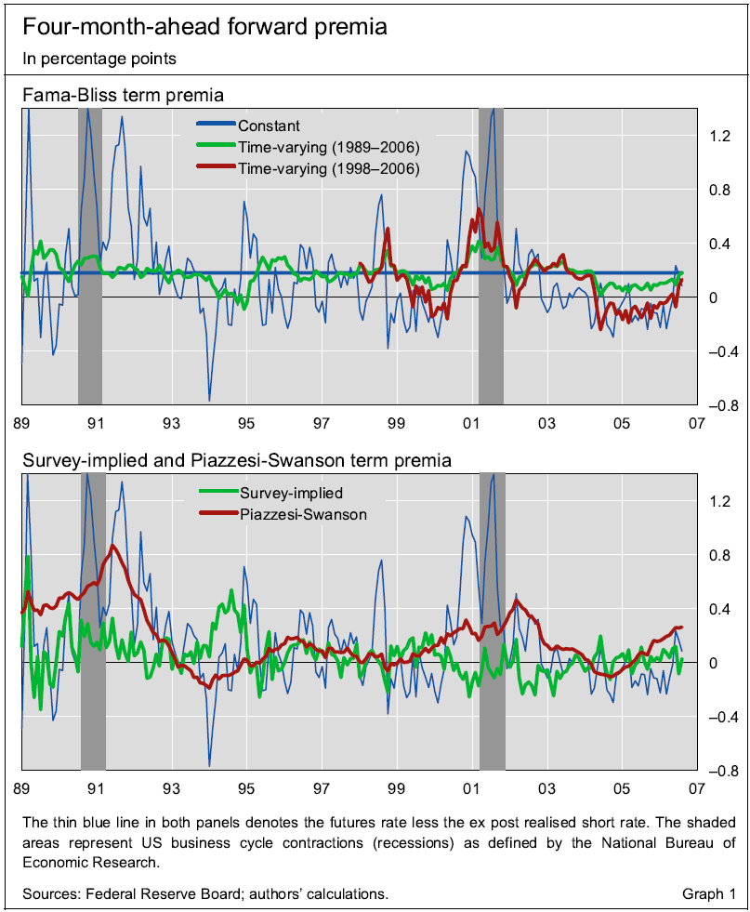
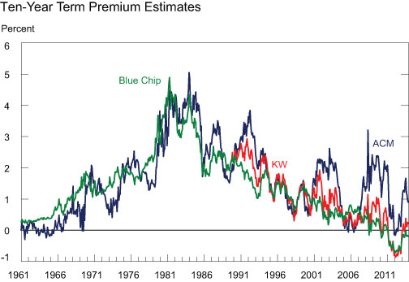
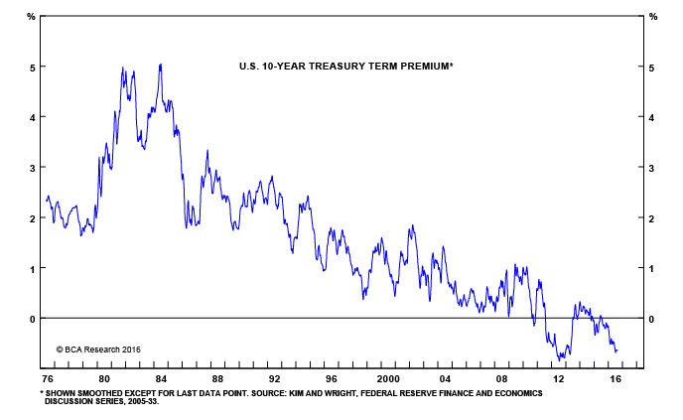
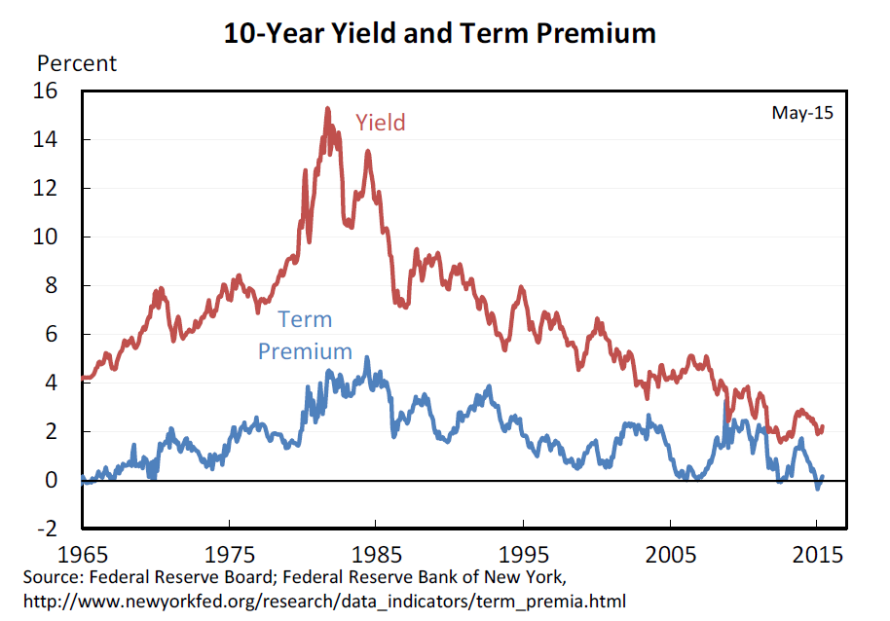
Fama-Bliss make carry trades sound smart
Carry trading
Notes:
The simplest way to add performance is «being long risk». If your portfolio has a slightly longer duration than the benchmark, it will tend to outperform its benchmark over time.. This works under the assumption of a positive term premium. If we combine volatile rates with standard utility functions, you can make a case for upward-sloped but convex yield curves. There is evidence that the term premium fluctuates over time. Fama and Bliss showed already 30 years ago (so, at the beginning of the long bull run in rates) that forward spreads contained information on future performance – thereby illustrating time-varying term premia. There is evidence that the term premium has turned negative more recently. [Discussion: any idea why?]
More: Eugene Fama and Robert Bliss. «The Information in Long-Maturity Forward Rates», The American Economic Review, No 4, Sep 1987, 680-692.
A relatively non-technical description of the bond term premium can be found in Don Kim And Athanasios Orphanides. “The bond market term premium: what is it, and how can we measure it’”, in BIS Quarterly Review, June 2007.

Slide 42
The term premium on bonds seems to have disappeared
Carry trading
Notes:
Carry works in the long run, as long as there is a risk premium. Such risk premia are impossible to observe directly. You will need a model to quantify the risk premium. For this, you specificy how the economy and financial market prices behave, given a certain yield curve. You fit this to past data and come up with a price explained by fundamentals and a residual. The residual is typically treated as the risk premium.
No it seems that since the financial crises of 2008, the term premium may have disappeared [any idea why this could be the case?]. Consequently, just running a long duration may no longer by a good strategy.

Slide 43

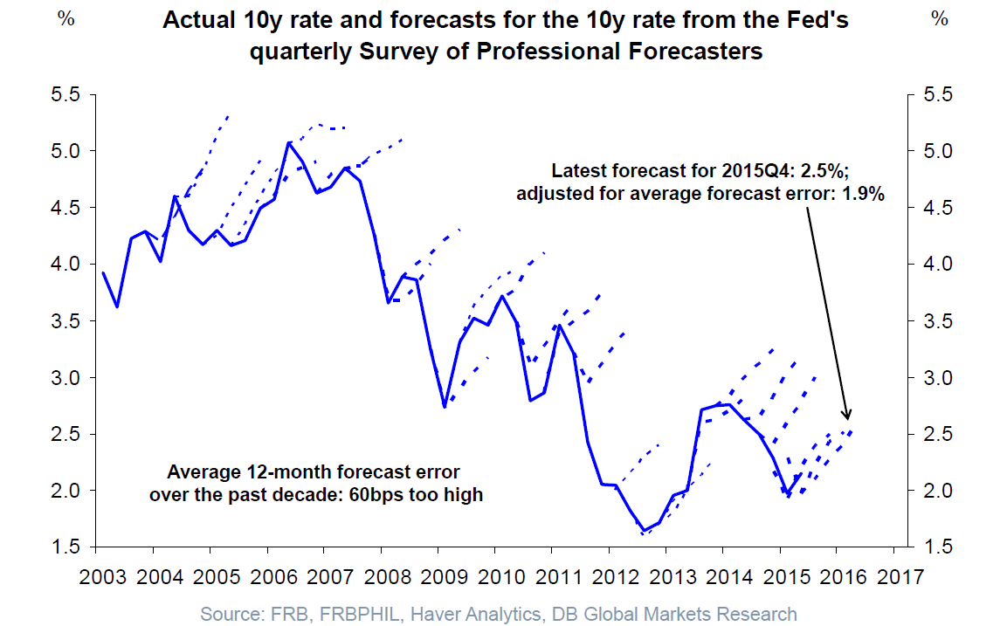
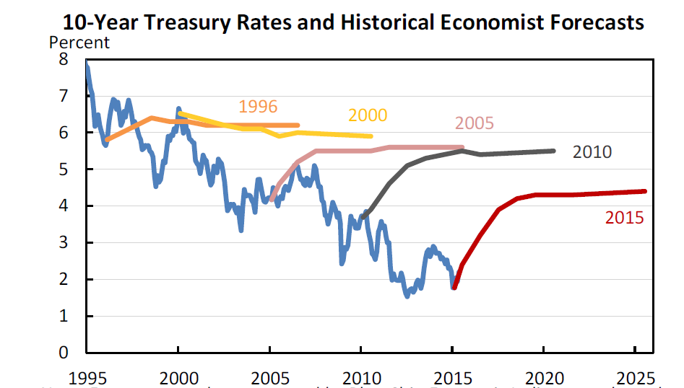
Fundamentally smart forecasts are in short supply
Fundamental
Source: «Long-Term Interest Rates: A Survey», Council of Economic Adivsors to the President of the USA, July 2015.
Notes:
You can also simply beat the market by being smarter than everybody else. Here you see an interesting chart plotting the forecasts of professional forecasters. That’s what they do for a living! If you are better than them, you may become the next Bill Gross.
[Discussion: What do we learn from such a chart?]
More: Smith/Lohrenz/King/Montague and Camerer, “Irrational exuberance and neural crash warning signals during endogenous experimental market bubbles” in Proceedings of the National Academy of Sciences July 2014. They show that it’s all brain chemicals, stupid!

Slide 44
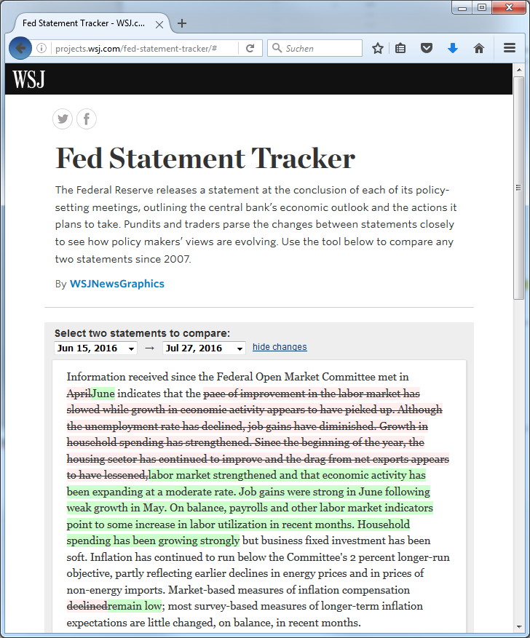
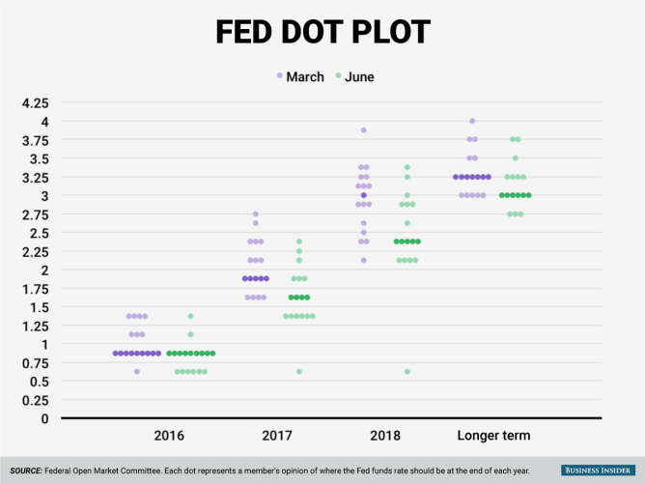
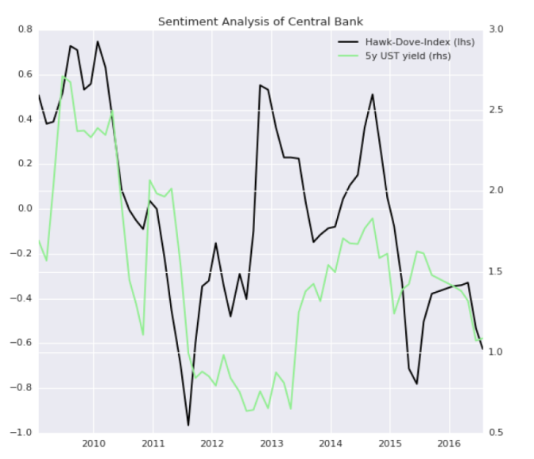
Fed watchers observe hawks and doves
Fundamental
Source: Zürcher Kantonalbank
Notes:
Fed watching is a popular flavour of fundamental trading. Hundreds of analysts follow in detail the public and not-so-public statements of monetary authorities. On the left, you can see an online tool that shows in detail any change in wording between two FOMC statements. Some analysts write very detailed linguistic studies while others screen the texts for positive and negative key words (e.g. our Hawk-Dove Index on the lower right). Monetary authorities themselves try out new ways of communicating their intentions – such as the “dot plot” on the upper right.
By the way:
Hawks =
Doves =
Fixed income managers who are able to forecast the next rate move better than the market can play this with short rate contracts (only worth the hassle with quite a bit of leverage).

Slide 45

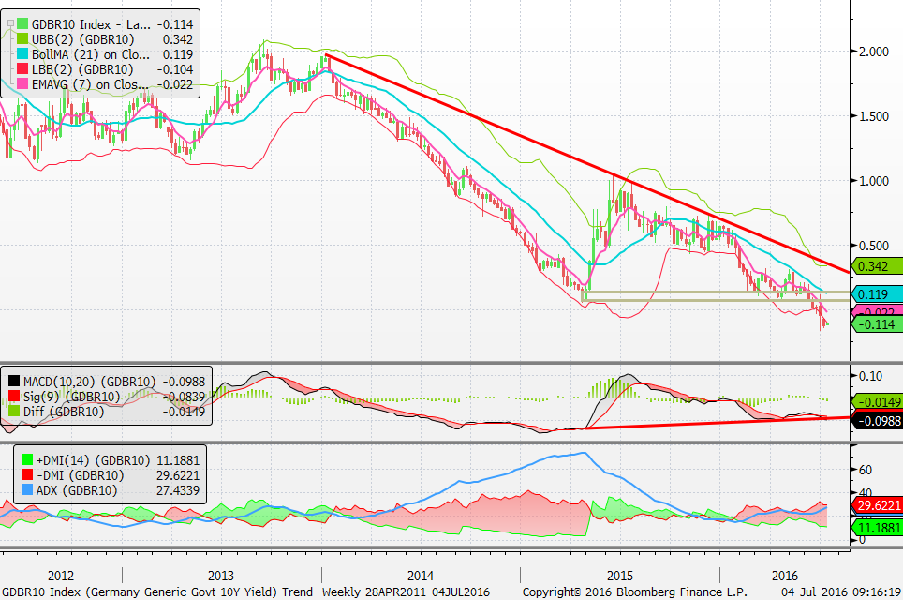
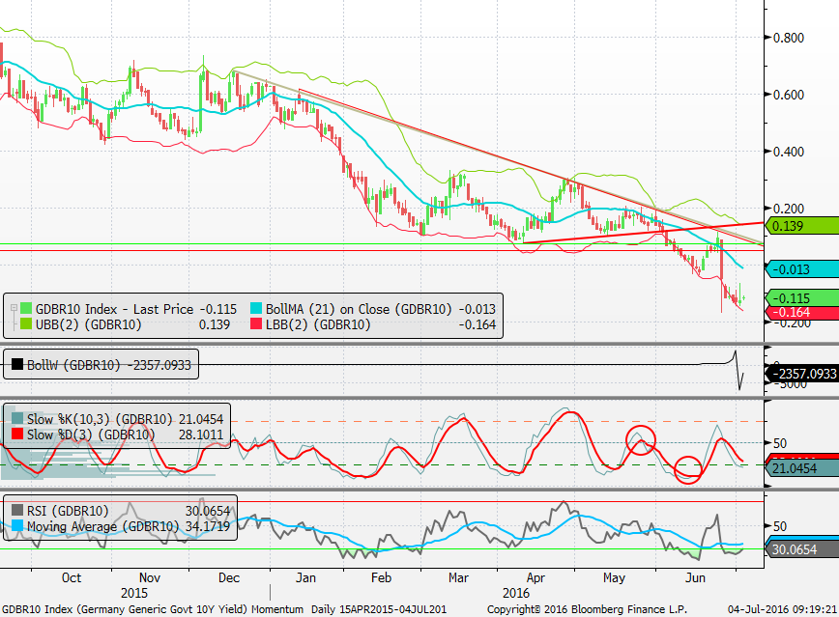
The trend is your friend
until it ends
Tech corner – DE 10yr
Weekly (long term)
downside developement – overall bearish to neutral picture. Lower highs but still no significant lower low yet. Crucial weekly close level 0.06%.
Trend Indicators bearish but weak.
Broke support of 0.06% and now should target -0.24%. New low and trend indicators bearish (but divergent as MACD is not confirming new lows yet)
Levels:
As long as we close above 0.06% bottom could develope
Close above 0.5% this week needed to stop bearish
Developement though.
Close below 0.06% would indicate bearish continuation (potential extension taget -0.24%)
Target nearly reached but still trend indicators negative. Picture remains bearish as long we trade below 0.15%
Technical
Daily (Short Term)
Triangle formation developing with momentum decline – setup for a break out move – could be larger move on either side!
Moved lower towards targets – RSI indicatoes oversold levels – sell rallies!
Levels:
Support 0.06%
Resistance 0.08% then 0.12/0.19%
Notes:
Academics do not take technical analysis (TA) seriously. Intellectually, it’s hard to swallow that simple trend lines should outperform sophisticated fundamental analysis and econometric models. On top of that, technical analysts tend to be a bit fuzzy (unable to explain why their forecast should work) and talk a funny lingo (this slide shows an example). Still, many practitioners use TA. Their point of view is that “all information is in the price”. The most solid empirical evidence in favour of TA comes from the idea of momentum (most TA is about identifying a trend). A whole industry of very rich hedge funds work simply on trends – so called CTAs.
More: google “turtle traders” – an amazing story that inspired a Hollywood movie (“Trading Places”).

Slide 46
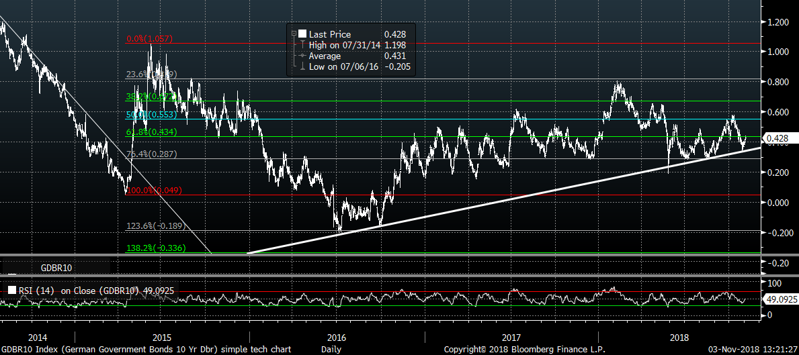
What magic stuff people look at
Fibonacci retracements and projections
Technical
Trendline (note: rising trend floor; falling trend ceiling)
RSI = Relative Strength Index
Notes:
This is not a course on technical analysis. Still, if you want to drop some concepts into small talk, you see here: trends, support and resistance (which can be found, for example using Fibonacci retracements), relative strength (RSI).
Some people look at specific pattern (e.g. the famous head and shoulders, wedges, double dips). Others prefer technical indicators like RSE, MACD, Bolling bands…

Slide 47
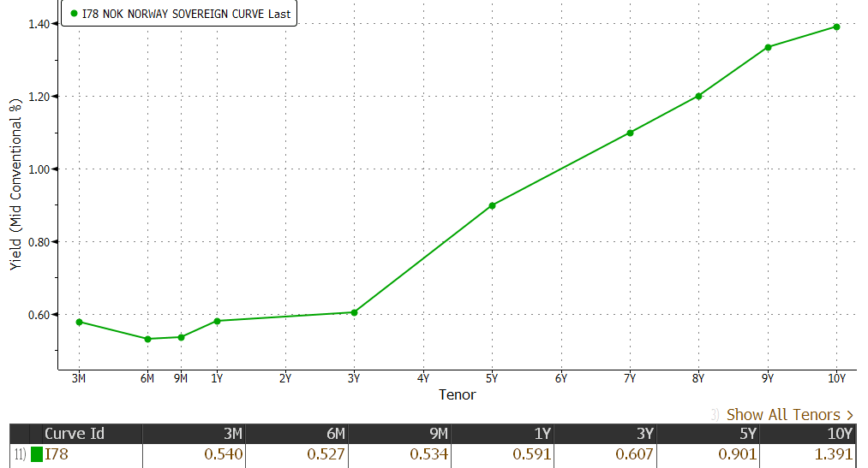
Bonds roll down the curve
Roll-Down
Running Yield
Notes:
Before we move on to curve trades, you need to understand an important idea: the roll-down. This expression stems from the observation, that yield curves tend to be upward sloping. When we approach final maturity, the yield tends to decline. This generates a capital gain.
This graph illustrates the principle. It’s the Norwegian government curve at the end of May 2016. Note the upward slope going out from 3-year bonds. Suppose now, you buy a 5-year bond. What would be the holding-period return under the assumption that the yield curve does not change? Practitioners would give you the following answer:
First, you earn the «coupon». The 5-year bond has a yield of 0.9%, so this is what you get over one year. This is referred to as the «running yield». You can visualize this part as the blue rectangle (holding period of 1 times the starting yield).
Second, at the end of the holding period, the 5-year bond will have turned into a 4-year bond. Now, in this example, the 4-year yield is roughly 15 bps lower. These 15bps correspond to a fall in yield that has a price impact of -DΔy. Again you can visualize this as a rectangle, this time the green one. D is roughly the tenor or the bond at the end of the holding period while the change in yield are the two points on the yield curve. This part is referred to as «Roll-Down»
In sum, the holding-period return under the assumption of a stable yield curve is the running yield plus the roll down. This is sometimes called the «rolling yield». Rolling yields can be positive even if the yield to maturity has turned negative.

Slide 48
Roll(ing) Yield = Running Yield + Roll-Down
Roll-Down
Rolling Yield
Running Yield
t
Notes:
On this slide, we look at exactly the same effect, using our rates chart. For simplicity, I skip intermediate tenors and only represent the ultimate and penultimate zero bond which have identical PV.
The slope between PV₀ and the last cash flow is z_{n}. If you start with PV₀ and accumulate this rate of interst over one period, you earn the blue rectangle. This is the running yield (again, we accumulate over one period by the beginning-period yield). If the yield curve does not change, the cash flow you bought with your zero rate is now discounted at the rate z_{n-1}. In the graph, this can be represented by using the same slope, i.e. we shift z_{n-1}. We can immediately see the impact of the roll down (again a green rectangel). Also note that we have constructed a parallelogram. Basic geometry tells us that the short sides of the parallelogram are. This means the line from PV₀ to PV₁ is identical to the line connecting CF_{n-1} and CF_{n}. This line is nothing else than the forward rate f_{n-1,n} ! So, the rolling yield of a bond with is identical to its furthest forward rate.

Slide 49
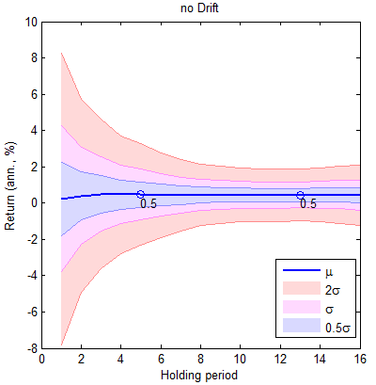
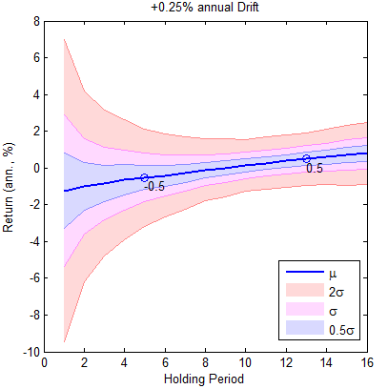
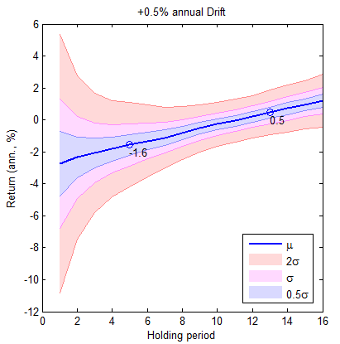
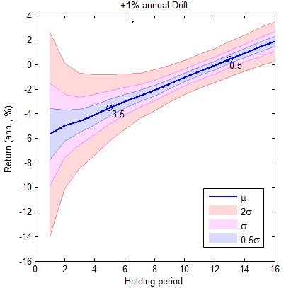
Rolling Yield is the best forecast for horizon 2D-1
Notes:
We have now established that the rolling yield is the holding-period return of a bond if the yield curve remains unchanged. Of course, unchanged yields are a strong assumption. However, the rolling yield contains another useful piece of information. It can be shown that long-run returns of a bond portfolio that is regularly reinvested around a certain duration will converge to the running yield. The charts above were produced in 2016 for the Swiss market. At that time, Swiss government bonds had a negative running yield but a positive rolling yield of around 0.5%. The graphs were produced for different «drifts». A drift of 0 means that the level of interest remains roughly unchanged; the dispersion comes from shocks with a mean of zero. In this case we see that the portfolio generates an annual return equal to the rolling yield; so far we are in line with the two previous slides. New is the fact that we start each year with the same duration and let the bond roll down one year. If we add a positive drift, interest rates increase over time at a certain rate. The last panel, for example, shows a drift of 1%. In the first year, this will result in massively negative return. However, as shown in our previous analysis for the Macaulay duration, the higher yield also means that capital will start to grow faster. It turn out that independent of the drift, you end up with an annualized return of 0.5% after roughly 13 years. In general, returns will converge to the rolling yield after a period of 2D-1 years.
Details: Leibowitz, Kogelman and Bova (2014), «Forward Curve Shifts and Return Convergence» and Leibovitz and Bova, «Rolling Yields and Return Convergence» in Portfolio Strategy, March 4, 2014.

Slide 50
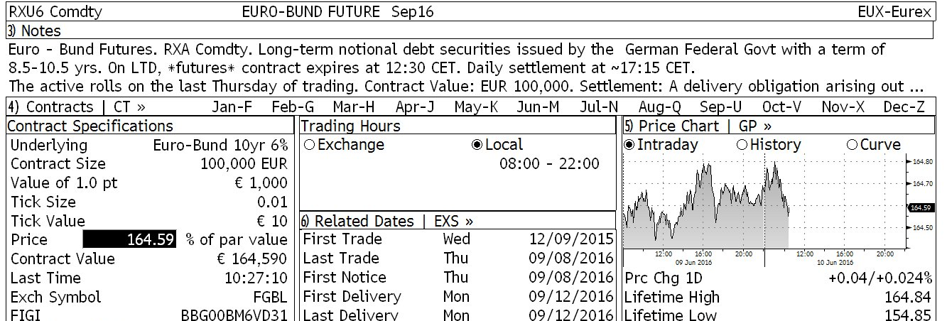
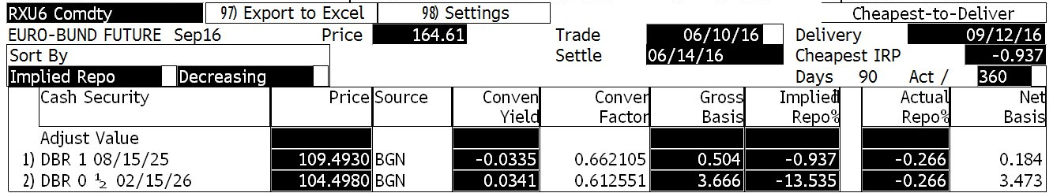
A brief introduction to bond futures
Notes:
After having considered different ways of generating duration trades, let’s have a look at how they are implemented. Of course, you can implement many trade ideas with normal bonds. Holding cash will reduce your average duration, buying long-dated bonds will lengthen it. This is all straightforward and – frankly – a bit boring. Things get more spicy, if we use derivatives. We start with bond futures.
A bond future is an exchange-traded forward contract in which you buy (long) or sell (short) a synthetic bond for a standardized settlement date and in a standardized amount (contract size). On this slide you see the example of the Bund future. Bunds refer to a 10-year German government bond. Settlement dates are normally March, June, September and December. So, when you go short the September bond future you sell the notional of 100’000 EUR in a synthetic 10-year Bund with settlement date 10-June-2016.
The idea of the synthetic Bund needs explaining. By definition of the exchange (Eurex), the synthetic Bund has a coupon of 6% and a maturity date exactly 10 years after the delivery date of the future. So, at the delivery date, you need to deliver this synthetic bond. Unfortunately, synthetic bonds do not really exist. What can you do? After all, there is not real bond that matches the description of the synthetic bond. Well, there are a couple of actual bunds that are sufficiently similar to the synthetic bond . The eligibility criteria for this basket is defined by the contract – here it says 8.5 to 10.5 years. The screen shows two bonds that fall into that bracket. So you have the choice of delivering any of these bonds. Specifically, look at the last bond in the list: you could deliver the DBR 0.5 2026. Now, this bond has a coupon of only 0.5%. A good deal for you. However, the person who bought the future may object; he bought a 6% bond and now gets only a 0.5% bond. In order to re-establish fairness in the trade, the exchange has defined a conversion factor. You see the formula on the slide. For this example, the conversion factor is 0.61 – meaning that each EUR of notional the 0.5% coupon bond pays 60cts of notional of 6% coupon bond. You thus have to delvier about 60% more notional in this bond. If you make a quick back-of-the envelope approximation, you can see that this is roughly the additional coupon accrued over the life of the bond. In the end, you can adjust all deliverable bonds by their conversion factor and chose that bond which is cheapest to deliver. This bond is called the «cheapest to deliver» or simply CTD.

Slide 51
Bond Futures Menu
Eurex | Schatz | Bobl | Bund | Buxl | Euro BTP
Issuer | Germany | Germany | Germany | Germany | Italy
Tenor | 2 years | 5 years | 10 years | 30 years | 10 years
Coupon | 6% | 6% | 6% | 4% | 6%
Basket | 1.75 – 2.25 | 4.5 – 5.5 | 8.5 – 10.5 | 24 - 35 | 8.5 - 11
Contract | 100‘000 | 100‘000 | 100‘000 | 100‘000 | 100‘000
 | US 2YR | Treasury | Long Bond | Gilt | JGB
Exchange | CBT | CBT | CBT | LIF - LIFFE | TSE
Issuer | US | US | US | UK | Japan
Tenor | 2 years | 10 years | 20 years | 10 years | 10 years
Coupon | 6% | 6% | 6% | 6% | 4%
Basket | 8 -13 | 6.5 – 10 | 15-25 | 8.75 – 13 | 24 - 35
Contract | 100‘000 | 100‘000 | 100‘000 | 100‘000 | 100 Mio
Notes:
Here is a choice of bond futures. There are futures traded in most markets – even in Switzerland. Not so in Norway, though. So, if you want to hedge interest rate with futures, you would need to proxy hedge with Bunds and Treasuries.

Slide 52
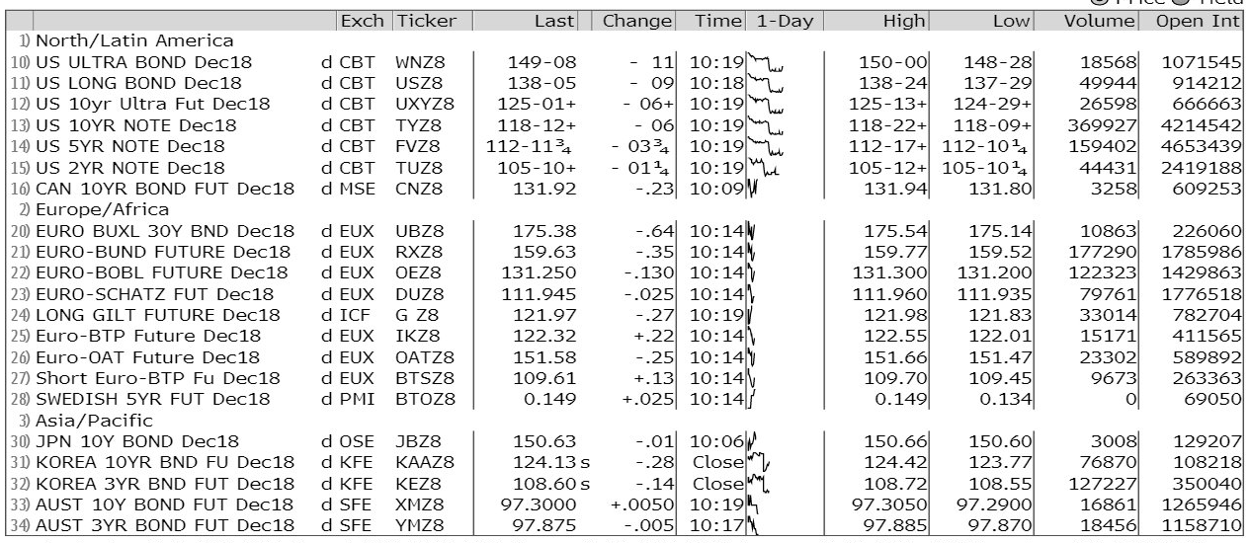
Bond futures are quite liquid
Notes:
Here a colorful Bloomberg screen WBF (World Bond Futures). Note the quoting conventions in USD.

Slide 53
Understanding the economics of bond futures
PV
t
Delivery Date
Notes:
On this slide, I would like to explain what happens when you buy a bond future. For this, it best to visualize the transaction as two positions.
You have a long position in the synthetic bond. On the slide, this bond has the blue cash flows. In the case of the bund, the coupons are 6% of the notional. Note in this chart that we are a few weeks (typically no more than 3 months) before the delivery date; cash flows start one year after the delivery date. As we showed before, the synthetic bond is not actually delivered. So you can substitute the synthetic bonds by 1/cv CTDs. The corresponding cash flow is represented by the lighter blue. The value of the 1/cv CTDs is given by 1/cv of the bonds price.
At delivery, you have to pay for the bond. The price you pay (CF) is the actual futures price. This is a negative CF. Viewed from today, this can be considered a short position in a zero bond that matures at the delivery date.
When you trade the future, the price of the future ensures that the market value PV of the two cash flow streams cancel out (at least roughly – there is also a delivery option which we generously ignore).
Now, what happens when interest rates change. Here the short version: when rates rise (fall), the upper / blue PV will fall (rise). The market will then change the price of the future (the CF) such that the two PV sum up to zero. Note that this triggers a mechanism called mark-to-market (MTM). This is highly important in practice but for the moment we do not dive into details. Simply remember that going long a future is economically equivalent to long bond and short zero bond position.

Slide 54
Δ-neutral portfolios using bond futures
Nominal
Value (V)
D
DV01
Bond 1
1,000,000
1,054,700.00
4.25
448.25
Bond 2
1,000,000
1,002,200.00
3.69
369.81
Bond 3
1,000,000
1,024,000.00
5.88
602.11
Subtotal Investments
3,080,900.00
4.61
1420.17
Futures – bond leg
-1,500,000
-1,800’000.00
7.89
-1420.20
Futures – cash leg
1,500,000
+1,800’000.00
0.05
+4.00
Subtotal Futures
-
N/A
-1416.20
Total Portfolio
3,080,900.00
0.01
3.97
Notes:
Let’s take what we just learned and see how we can use it to manage duration risk. Suppose you want to insure your portfolio against a shift in yields. This works as follows
The bond portfolio consists of a couple of bonds. Each bond has a market value and a duration. We introduce the concept of DV01 (basis point value, sometimes also denoted as BPV). You get DV01 by taking the product of the market value of a bond position with the duration; you then need to divide by 10’000 (bp = 0.01%). DV01 tells you: how much (in monetary terms) does the value of the position change if the yield changes by 1bp?
As this is an absolute figure, you can add it up across your bond positions. This gives the DV01 of the investments («cash bonds»).
Now take a future. We sell 15 futures contracts. As we’ve seen, this translates into two legs – a short bond leg and a long synthetic cash (or zero-bond) leg. Both legs have a value and duration. So you can calculate the DV01 for each leg. Their sum is the DV01 of the futures position. Note that the value of the futures contracts is zero.
Summing up the DV01 of your investment with that of the Futures gives the total DV01. You can see that this now very close to zero. If you want, you can also translate this back into duration terms normalizing (divide by the portfolio value) and size it back to full value (multiply by 10’000).
In practice, I would take a shortcut on the futures trade. Instead of doing the calculation for cash and bond separately, I would simply adjust the duration of the bond by that of the cash leg (or not bother at all). You could also use directly the duration of the synthetic bond at the delivery date and with the price of the future.

Slide 55
Δ-neutral ≠ risk-free
DV01
D
Notes:
Let’s have a closer look at this example. For this, I draw a new kind of diagram. Each bond (including the two legs of the future) is represented as a bar. The height of the bar (the y-axis) is the DV01 of the position; the duration of the bond is mapped on the x-axis. Another label for the y-axis would be the «contribution to duration» - you simply need to translate DV01 into duration by dividing by the portfolio value and multiplying by 10’000.
This is an animated slide, so you will not see everything on the printout. But the principle is simple: If the Δy is the same for all, the first-order impact will be proportional to DV01. Falling yields will generate an increase in the value of positive DV01 and vice versa. When the DV01 add up to zero, the sum of the DV01s multiplied by an equal Δy has to be zero as well. This is true for both positive and negative yield shocks. Of course, if Δy is identical for all durations, we have a parallel shift of the yield curve. Profit and Losses (P&L) of the futures offset the P&L of the bonds.
The situation changes when Δy changes for different maturities. For example, if rates rise for long maturities and fall for short maturities, you may have a gain on the short position in the future and no offsetting loss for the bonds. Therefore, a delta-neutral portfolio has not eliminated interest-rate risk for all scenarios.
By the way: Delta-neutral portfolios are also not immune against large interest rate shocks. This is due to convexity. Remember that the duration effect is only a first-order approximation. If there are large shocks, the convexity effect will always be more positive for long-duration bonds.

Slide 56
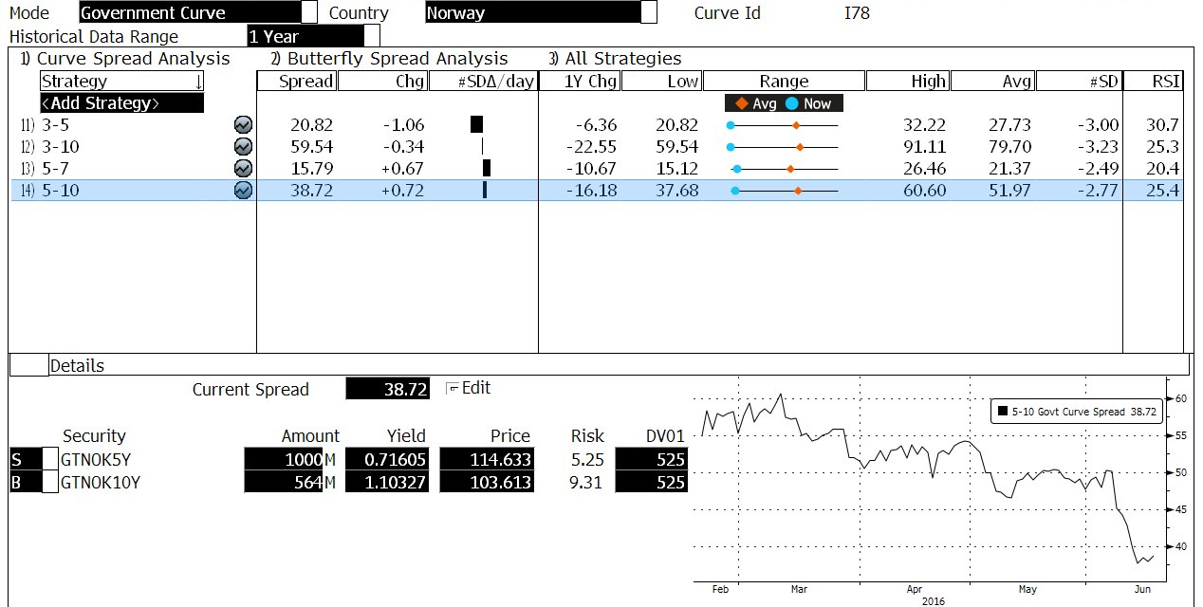
Steepeners, Flatteners, Butterflys
Notes:
In active portfolio management, we often place bets on the slope and shape of the yield curve. The most popular trades are steepeners and flatteners. Here, I have picked the 5-10 segment of the Norwegian government curve. The little chart shows that the curve is flatter in this segment than it has recently been; this may suggest a steepener. In a steepener trade, you expect the curve to get steeper, i.e. the longer maturities will raise more or fall less than shorter maturities. This means that the 5-10y spread (the 10y yield minus the 5y yield) increases. If that’s your view, you go short the 10y bond and long the 5y bond. Now, if you do this with equal amounts, you will end up with a short duration position. Therefore, positions have to be sized by DV01. This ensures that only the spread between the two rates has an impact on your P&L and not the general direction of yields.
Flatteners are the opposite of steepeners. You then go long the 10y and short the 5y bond. Finally, you may want to play a butterfly. These are trades on the curvature of the yield curve. For example, you may go long the DV01 of 1000 NOK in the 5y bond, and short each 500 NOK in the 3y and 10y.

Slide 57
Bullets and barbells
weight
bullet
barbell
barbell
D
Notes:
One popular way of describing curve bets is in terms of bullet vs barbells. In the chart, the grey bars represent the benchmark. The dark blue portfolio concentrates in intermediate maturities; this is called a “bullet”. The turquoise portfolio, in contrast, puts the weight in the wings; this is called a “barbell”. Suppose the yield curve rotates around intermediate maturities, without a change in average yields. The bullet will therefore remain roughly unaffected. Not so the barbell portfolio. The change in yield on long maturities will be approximately identical to change in yields on short maturities but with opposite signs. As the duration in the long maturities is higher, the price impact will also be higher. Consequently, barbells outperform (underperform) bullets in a flattening (steepening) scenario.
Keep in mind that this chart is showing weights rather than DV01. If we put the same weight in short and long duration bonds, we allocate much more DV01 in long duration bonds. You can interpret this as putting a relative bet on long maturities versus short maturities. In a flattening scenario, this pays out and as long total DV01 is the same, the portfolios perform the same under parallel shifts.

Slide 58
Floaters can be used as substitute for term deposits
t
Notes:
Let’s quickly look at two other instruments used for managing interest rates: floaters and swaps. On this slide you see the example of a floater (floating-rate notes, FRN). Floaters have periodic coupons (typically quarterly) that are fixed, at the beginning of each coupon period to the current LIBOR rate. So, at the onset, all coupons except the first one are unknown. How can we price an instrument with unknown cash flows? The answer turns out to be very simple. First, we have to realize that the best guess of future coupons of a risk-free floater is given be the forwards. Take the last coupon first. The 5th coupon will be equal the short rate at the beginning of the period. The current best guess for this is the forward rate f_{4,5}. We now know that the price of the bond at the end of the last period is PV₅ = 100 (the capital). Add to the this the expected coupon to get 100*(1+f_{4,5}) to get CF at the end of the period. Discount this back to τ=4, so you get PV₄ = 100*(1+f_{4,5})/ (1+f_{4,5}) = 100. You can move like this all the way back to PV₀ to find that the price will always be 100.
Now, let’s see how this bond reacts to interest rate changes. Take a shock to a forward rate first (which is the most generic case of any change in spot rates). As an example, assume a rise in f_{2,3}. You can immediately see that this has no impact on PV₂ – yes, you now expect a higher cash flow, but this is immediately offset by a steeper discount. If PV₂ is unchanged, so is PV₀. Conclusion: Floaters are not sensitive to changes in forward rates.
The only rate that affects the price of the bond is the short spot rate z₁. If this rate rises, PV0 will fall. This is explained by the fact that the first coupon is fixed at the beginning of the coupon period. So at the moment the rate is fixed, the bond has the properties of a zero bond that matures at the first coupon payment. This is also the characteristic of a term deposit.

Slide 59
Swaps taste like plain vanilla
PV
+100
Floating
t
-100
Fix
Notes:
In one of the previous slides, you have seen the economics of bond futures. Let’s now have a brief look at interest rate swaps. Interest rate swaps are over-the-counter (OTC) instruments while bond futures are exchange-traded derivatives (ETDs, sometimes also referred to as TOFF for traded options, futures and forwards). In a normal interest rate swap – so-called plain vanilla swaps, also IRS - you exchange a fixed cash flow stream for a floating cash flows stream. Floating means again that the amount is adjusted at the beginning of each period to the LIBOR rate. A payer swap is a plain vanilla swap where you pay fixed and receive floating. Receiver swaps are the opposite.
On this chart you see the economics of such a swap. The graph shows the periodic cash flows. This almost looks like a bond; the only thing missing are the capital payment in the end. Suppose for a moment, there are capital payments both on the fixed and the floating leg. As the amounts are identical, this doesn’t change the net position. You now do have two bonds: a short position in a fixed coupon bond and a floater on the long side. As we have shown the value of the floater is 100.
On fixed side, we also have a bond. When we set up the swap, this bond will be a par bond (the coupon rate will be such that the price is exactly 100). Over the life of the swap, the fixed leg will behave like a bond with a fixed coupon. The floating part, in contrast, will behave like a term deposit. You can use this decomposition to value the swap and to model its risk.

Slide 60
4
Inflation really matters
Notes:
In this chapter we are going to talk about inflation. Yes, a whole chapter just about inflation. You may think that this is a lot of honour for a marginal topic. But I disagree. Inflation is the single most important variable affecting bond investors.
After this section you should be able to
Understand the rational for investing in real and nominal assets.
Understand the effect of changes in expected and realised inflation.
Translate your inflation view in portfolio positions.

Slide 61

Notes:
Potatoes have some similarities with but also some differences to fixed income instruments. Think about the potato choice. This works like this: Imagine you get a potato. You then have two options: (1) Eat the potato or (2) plant it in your garden. What would make you chose (2) rather than (1)? There are two factors:
You are not hungry; the potato (or its offspring) will stay eatable for a long time (compared to the potato in the fridge); your garden is safe from mice
You expect that if you plant one potato, you will able to harvest many potatoes in the future
In financial terms, these two factors can be translated as the motifs of (real) capital preservation and (real) yield. Real capital preservation is about postponing consumption opportunities from today to the future. Real yield, in contrast, is about earning something. In traditional financial economics, the real yield is the compensation for time preference – you want to be compensated for suffering impatience or for the risk of death until consumption. When I started managing fixed income portfolios twenty years ago, it was a given that the real yield had to be always positive. Today, there is overwhelming evidence that real yields can be negative.
The major difference between a potato and a bond is the sensitivity to price levels. The potato choice is real choice. Inflation does not matter at all. Potatos do not grow faster in high-inflation economies. Bonds, however, do. Bonds maintain a nominal capital and give you a nominal yield – not real ones. Once you buy a bond, you know exactly how much cash you will get, but you never know how many potatos you can buy with them. With other words, the risk-free nominal asset may carry a high real risk.

Slide 62
Nominal rates = real rates + inflation compensation
t
62, 3. November 2018
Notes:
Taking the potato into our interest charts, we can decompose nominal rates in two components:
Real yields. I use the notation r_{τ} for the real yield with tenor τ
Expected inflation (maintaining purchasing power). I use E[π_{τ}] for the expected inflation ratio over the next τ periods.
We then have zτ = r_{τ} + E[π_{τ}] .

Slide 63
Real yields fluctuate around the real rate of growth
12
10
Inflation
8
6
Yield Swiss Govies
4
2
0
«real yield»
-2
-4
-6
1950s
1960s
1970s
1980s
1990s
2000s
2010s
Source: Bloomberg / Benno Weber
Notes:
Since WWII, we have experienced a long episode of inflation and deflation resulting in shifts in nominal and real interest rates.
On this slide you see the data for Switzerland. Just looking at nominal interest rates we see a peek in yields in the 70s, then again in the 90s. Mapping the current inflation against yields, we see that the episodes in higher yields coincide with episodes of high inflation. It seems that the general trend is actually driven by inflation. Finally, taking the difference, we obtain a “real yield” measure. The simple subtraction is seriously flawed because it compares forward-looking yields (from τ₀ to τ_{n}) with backward-looking inflation rates (from τ₋₁ to τ₀). Still, it gives a rough indication of what is your real running yield. Interestingly, the “real yield” was lowest when nominal rates were highest – probably, the Swiss expected the high-inflation episode to go away quickly. And, just looking at “real yields”, we do not see the long cycle observed in nominal yields. Instead, “real yields” fluctuate around a stable value of about 1% - roughly the real growth rate of the Swiss economy.

Slide 64
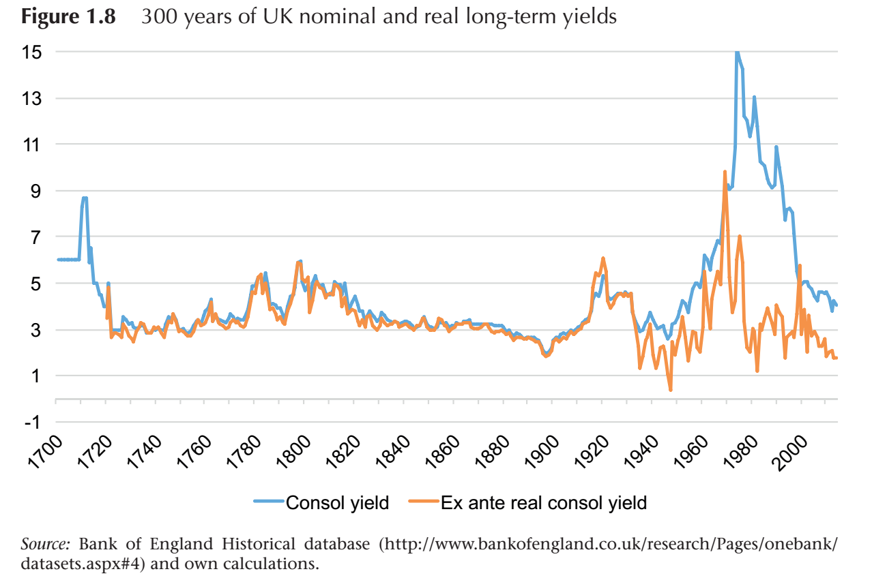
20th century is an outlier
Notes:
A colleague of mine took this chart from a publication; unfortunately I was not able to find the reference. Still, I think it is a great illustration of the development of nominal and «real» yields over a very long time period. Note how nominal yields overshoot real yields – that’s more than 20 years of painful disinflation.

Slide 65
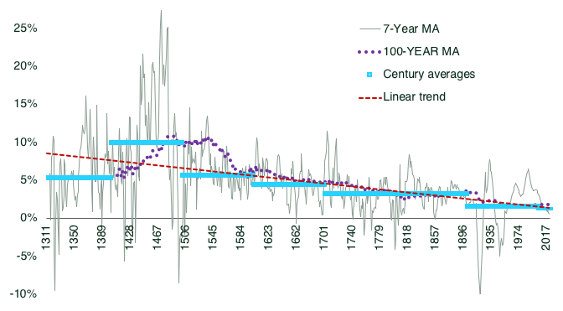
Still, evidence of falling real yields
Source: voxeu.org

Slide 66
Inflation-linked bonds are the real risk-free asset
t
66, 3. November 2018
Notes:
Suppose, you just invested in a bond with a nominal yield. You expect a certain rate of inflation. Your investment provides you a certain cash flow. In sum, you expect to be able to buy some consumption opportunities (e.g. potatoes) in the future. Now, unexpectedly, inflation expectations jumps up. What happens?
Well, your CF is fixed in nominal terms. However, in order to purchase the consumption opportunities you intended to (e.g. the amount of potatoes), you would need more cash. At maturity, you simply don’t have the cash needed to buy your potatoes at the new price. That’s a real loss.
At first sight, you may think that your loss occurs over time. Each year with high inflation eats away purchasing power. However, this simple view is only true if you hold your capital in cash stuffed under the mattress. Remember that you bought a bond. As inflation rises, there is no a priori reason that this is immediately offset by a fall in real yields. Consequently, ceteris paribus, higher inflation expectations lead to higher nominal yields, and finally lower bond prices. Conclusion: the moment inflation expectations rise, you immediately realize the real loss that will accrue over the life of the bond.

Slide 67
Inflation-linked bonds are the real risk-free asset
t
Notes:
Inflation-linked bonds (ILB) provide protection against shifts in expected inflation. The key idea is to adjust the CF to realised inflation. If inflation expectations rise, also expected cash flows will rise. Assuming that real rates remain constant, this will be exactly offset by a steeper discount. PV will remain unchanged.
Important: This mechanism only works for changes in inflation. Inflation-linked bonds are still sensitive (with the lever of real-rate duration) to changes in real rates.

Slide 68
Coupons and/or capital grows with inflation
140
Non-Accreting
10
140
Accreting
10
9
9
120
120
8
8
100
7
100
7
80
6
80
6
5
5
60
4
60
4
40
3
40
3
2
2
20
20
1
1
0
0
0
0
1
2
3
4
5
6
7
8
9
10
1
2
3
4
5
6
7
8
9
10
Notes:
There are two inflation-linked structures:
In non-accreting structures, Coupons are defined as a fixed rate (e.g. 3%) plus effectively realised inflation. Capital remains 100, hince falling over time in real term. This is the typical structure of inflation-linked notes.
In accreting structures, Capital is index to a price index, hince staying constant in real terms. Coupons are then calculated at a fixed rate on this growing capital – in the end everything is just getting inflated by inflation. Real coupons remain constant as well, allowing periodic consumption of a representative consumer basket. This is the standard method used in government-issued ILB.

Slide 69
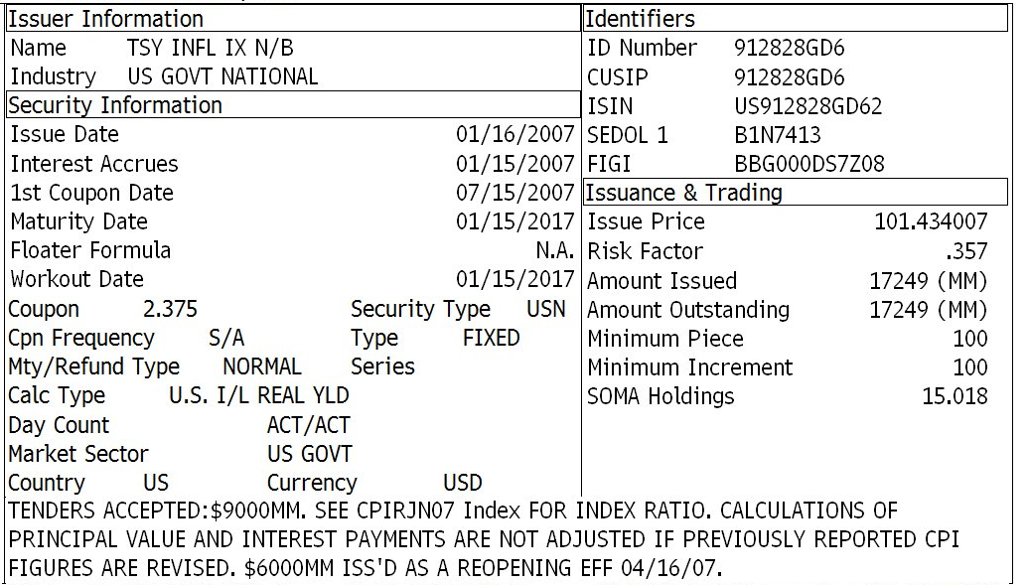
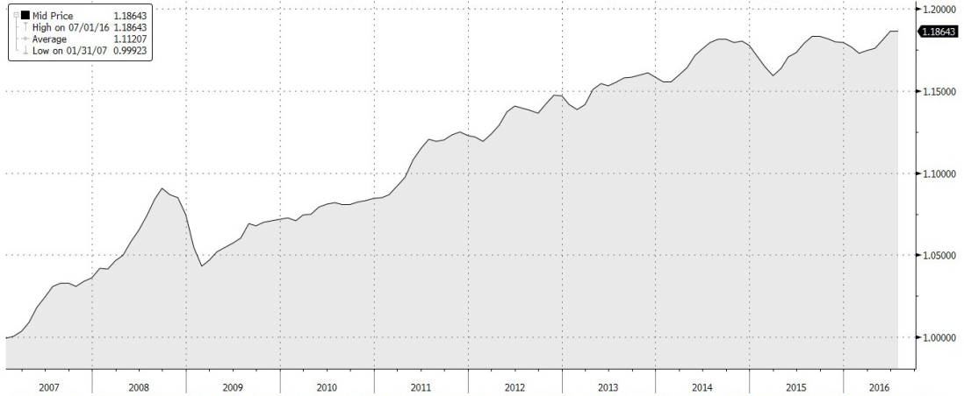
TIPS
Notes:
Here an example of a US Treasury inflation-linked security (TIPS) . This bonds been issued in 2007 and matures in January 2017. The real coupon is 2.375 (yes, that was a typical real coupon before the financial crisis). In the notes they refer to an «index ratio»; this is nothing else than an indexed CPI. Looking at this index, we see that prices have increased by roughly 18% over the life of this bond.
The first inflation-linked bond was issued already in 1780. Modern inflation-linked bonds exist since 1981 with the issuance of the first index-linked Gilt (UK Government bond). France and the US were other early issuers. Germany, Italy, Canada, Australia and Japan have started to issue more recently. In the Nordics, Sweden issues ILBs. In NOK, the largest ILB is a bond issued by Niam Fund (Real estate); issue size 1bn NOK; this bond is not listed.

Slide 70
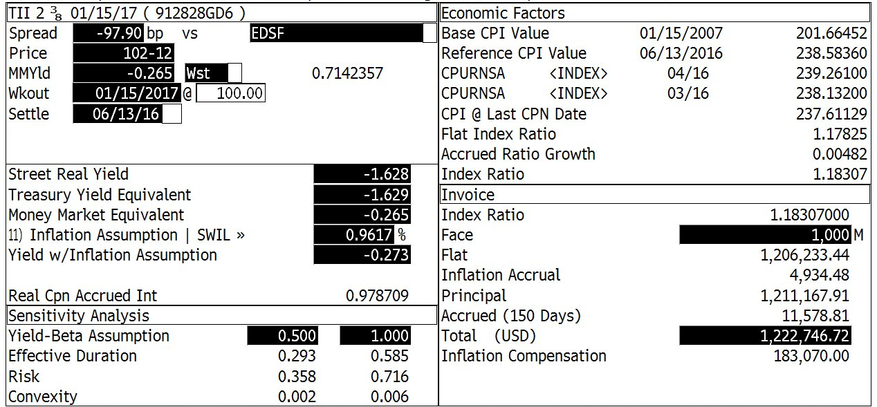
Interpreting analytics of ILB
The (clean) price of the bond is 102.12
Real yield is -1.63%
Nominal yield depends on inflation assumpiton
The price you actually pay depends on the index ratio
Nominal duration depends on beta assumption
Notes:
This is an analytical screen showing how a portfolio manager would look at such a bond. Note in particular how the «yield» (which is a nominal yield) is depending on the inflation assumption.

Slide 71
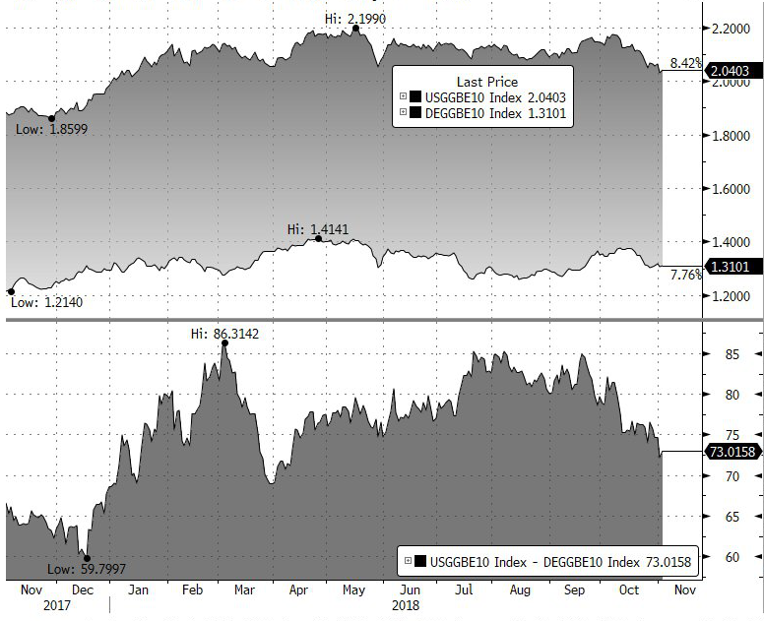
Breakeven trades
US 10-year breakeven
EUR 10-year breakeven
Source: Bloomberg 2-Nov-18
Notes:
On the previous slide, you’ve seen that the nominal yield of an ILB depends on the inflation assumption. This leads directly to the concept of the breakeven rate: the breakeven is the inflation assumption that makes the (expected nominal) yield of the ILB identical to the yield of a comparable nominal bond. If the market is efficient, the breakeven rate can be interpreted as the market expectation of inflation over the life of the two bonds. This breakeven rate varies over time – reflecting shifting inflation expectations.
Breakevens can be traded actively. If you expect inflation to be higher than the breakeven, you may want to overweight the ILB because it will outperform the nominal over the remaining life. On a more short-term basis, you can try to play the mean reversion (buy linkers when everybody prices in deflation) or cross-currency trades (be long EUR breakevens vs short US breakevens when you observe that the US are faster to price in shifts in, say, oil prices).

Slide 72
Financial markets focus on the reflation-game
Euro Stoxx ()
5y5y inflation forward ()
Source: Bloomberg 27-6-16
Notes:
Why should equity markets care about inflation? After all, stocks are real assets. Nevertheless, they do. On this chart you can see that the equity market moves in sync with 5y5y inflation swaps. I would argue that it’s inflation expectations driving financial markets. Again, fixed income markets dominate the world!
[Discussion: What’s the macro story behind this?]

Slide 73
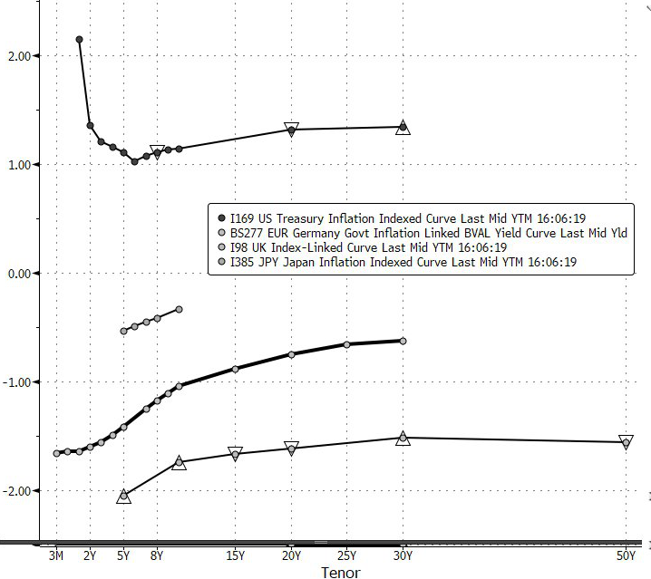
Forget everything you learned: Most real rates are negative
US TIPS
Japanese ILB
German ILB
UK Linkers
Source:Bloomberg 2-Nov-2018
Notes:
In this chart you see current (as of June 2016) yield curves of four major ILB markets. The chart shows that these markets are in negative territory. In US TIPS, you need to go out to 9 years if you want positive real yields. In Germany, the UK and Japan, real yields are negative for all available maturities. This is a rotten potato!
[Discussion: What are the implications of this? Are ILB therefore worse than nominals or cash?]

Slide 74
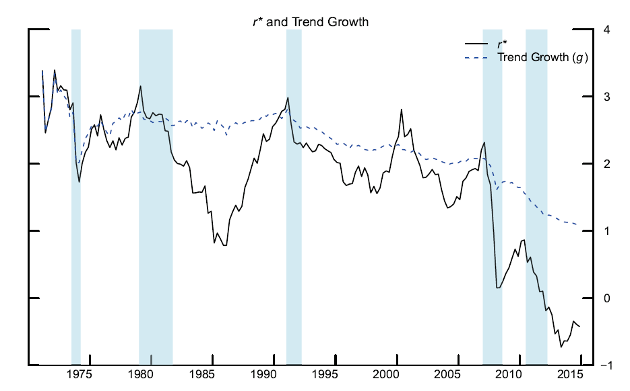
Natural real rates are probably negative
Trend growth (g) and natural real rate (r*) of the Euro area
Source: Holston, Laubach and Williams (2016)
Notes:
Over the last couple of years, real rates have fallen dramatically. There is an ongoing debate whether this is just a low within a major correction or if we have entered a long stage of very low or even negative equilibrium rates.
Details: Kathryn Holston, Thomas Laubach, John Williams. «Measuring the Natural Rate of Interest: International Trends and Determinants», Federal Reserve Bank of San Francisco Working Paper, June 2016.
You may also want to look into the secular stagnation debate; a good starting point would be the blog on larrysummers.com.

Slide 75
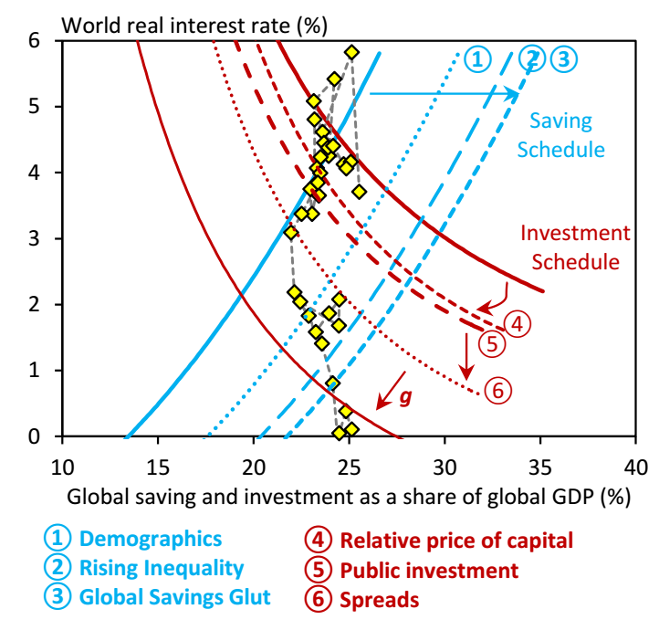
Macroeconomists struggle to explain low/negative real rates
Rachel & Smith 2015. Secular drivers of the global real interest rate.
Notes:
This slides summarises the mainstream view explaining low real yields. For this, the authors list six factors driving the savings-investment schedule. The factors explain the bulk of the shift. Some of it remains unexplained. Going forward, the authors expect the unexplained to go away but, on balance, the major shifts are here to stay.
Explanations
Demographics: global ageing and the life-cycle theory (people save in anticipation of retirement)
Inequality: Income is more and more concentrated, and these rich consume less than the poor
Savings glut: Emerging markets build up reserves after Asian crisis and in form of petrodollars
Relative price of capital: 30% decline
Public investment: trend decline since 1980s, driven by austerity
Spreads: Market price of risky investments over risk-free rate has increased.
g is an approximation for growth effects.
Details: http://www.bankofengland.co.uk/research/Documents/workingpapers/2015/swp571.pdf. Or http://www.imf.org/external/np/seminars/eng/2015/secularstag/

Slide 76
Why would you take inflation risk?
Source: BIS Quarterly Report Sep-2018
Notes:
To round of the chapter on linkers, ask yourself a simple question: Why are people willing to take inflation risk? In the end you want to eat your potato. So, the only reason for taking a risk should be a risk premium, right? This chart (and the one on the next slide) shows that the risk premium you get for accepting an inflation risk is very, very small at best. The «inflation risk» is that current market expectations of zero inflation forever may be mistaken.

Slide 77
Why would you take inflation risk?
US
EU
Source: BIS Quarterly Report Sep-2018
Notes:
[see above]

Slide 78
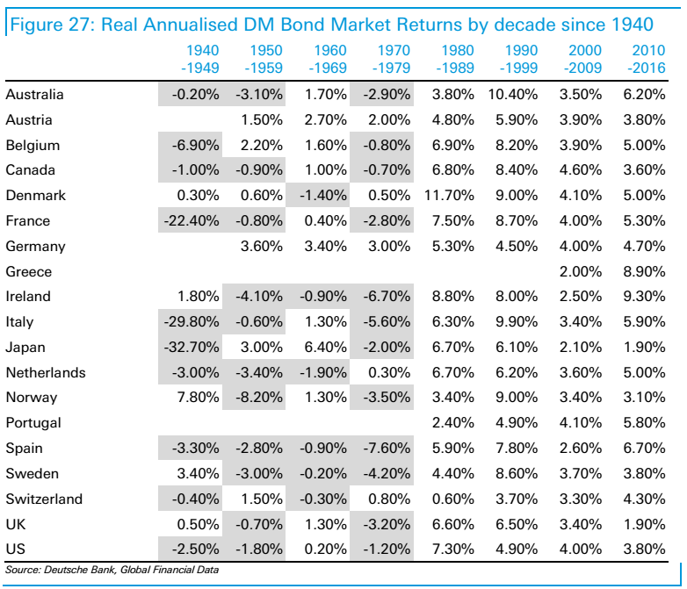
In sum: bond markets had a great time
Notes:
A final slide on real yields / returns. Note how «financial repression» worked after WWII. Bill’s bull run has now lasted for more than 30 years. Unlikely to continue.

Slide 79
5
Managing Credit
Notes:
So far we have taken the cash flows as given. By adding a credit dimension, we add an additonal element of risk. This risk is both a risk of credit loss as well as a source of volatility. I will spend some time on credit analysis. But this is certainly not a course in the art of credit analysis. I also show some instruments that can be used to add juice to a portfolio or to hedge credit risk.
After this section you should be able to
Understand the various types of credit risk.
Put credit ratings in context with credit analysis.
Understand the impact of your credit allocation on the overall risk of a fixed-income portfolios.
Implement you view on credit by using cash and derivative instruments.

Slide 80
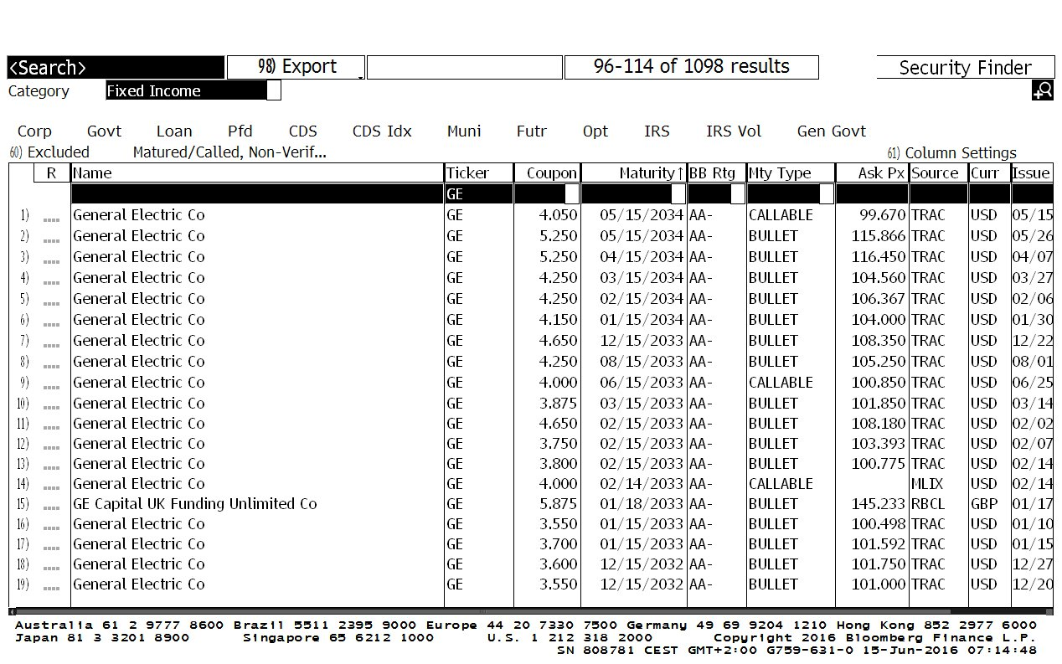
One stock – hundreds of bonds
Notes:
This is what you get when you ask Bloomberg to list all GE bonds. Note that the screen only shows one of many, many pages. There are more than 1000 bonds issued by GE. The company has one stock. Most listed companies issue fixed income instruments. Many issuers of fixed income instruments are not even listed.

Slide 81
Corporate bond market shows disintermediation
Market value (USD trn.)
8
Utilities
7
6
Financials
5
4
3
2
Industrials
1
Source: Barcap Live
0
06.2006
12.2006
06.2007
12.2007
06.2008
12.2008
06.2009
12.2009
06.2010
12.2010
06.2011
12.2011
06.2012
12.2012
06.2013
12.2013
06.2014
12.2014
06.2015
12.2015
Notes:
In the introduction, we showed that the size of the global corporate bond market (including only bonds with remaining life of at least one year and an issue size of at least 300 mio USD) now stands around USD 8 trn. Note how the composition has changed. [Discussion: How do you interpret the data on the chart?]
Keep in mind that «credit» does not automatically mean corporate bonds. In fact, government bonds are also subject to the risk that cash flows turn out later and lower than anticipated.

Slide 82
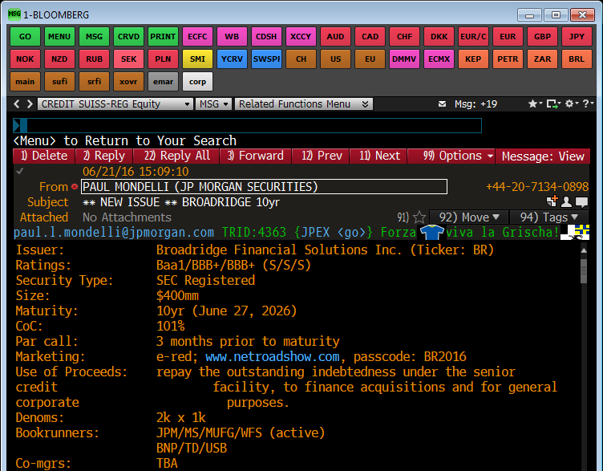
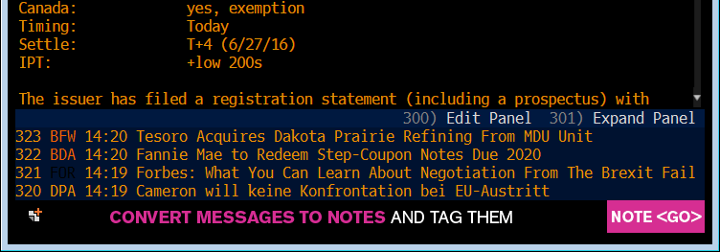
Bonds are generally bought on the primary market
Notes:
Here an example of a 10-year bond issued by Broadridge. This company needs cash to repay debt as well as for acquisitions and «general purposes». In order to get the funds, the treasurer gives a mandate to an investment bank. The mandate includes advice, syndication, structuring, underwriting and placement of the security. For this service, the investment bank is handsomely paid somewhere between 0.25%-5%. The investment bank advises the issuer on the best timing and maturity of the transaction; this can be driven by pre-deal consultations (over the wall) or even by reverse solicitation (large investors asking for a new bond by a certain issuer). Normally, other investment banks are invited to the transaction (placement and underwriting capacity). Once the issuer has an idea of the terms, the investment bank will draft a prospectus of the security, apply for security identifiers and files the registration statement with the regulator or an exchange. Many investors also require a rating; therefore, the investment bank arranges for ratings by one or more rating agencies. New issuers will typically go on a roadshow to market the upcoming transaction with potential investors. On the day of the launch, sales contact potential investors with such Bloomberg messages (here an example of a Paul Mondelli, a salesman of JP Morgan). They may do this as underwriters (take the left-overs on their book) or on a best efforts basis. As an investor, you can place an order with any of the bookrunners.

Slide 83
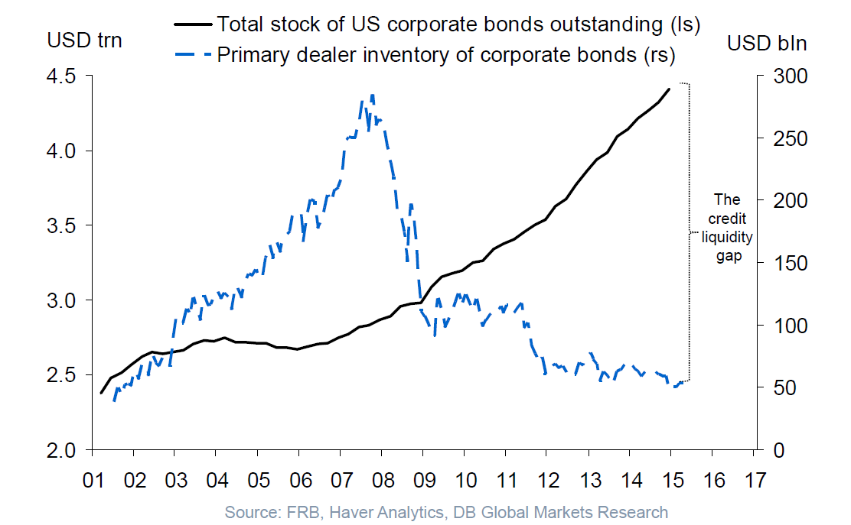
The street is shrinking
Notes:
We’ve seen that, traditionally, investment banks play an underwriting function in the primary market. With new banking capital regulation, this has become a costly exercise for the banks and they have moved more and more to a best-efforts model. In addition, trading books have been curtailed in order to reign in risk. As a consequence, apparent liquidity in the secondary market has decreased. However, the conclusion is not as straightforward. While dealers provide liquidity in normal times, they cut back their positions when things get really nasty. So, low bid-ask-spreads in good times may mask a lack of underlying liquidity.
More details available on the net: “Shifting tides – market liquidity and market-making in fixed income instruments”, BIS Quarterly Review, March 2015.
[Discussion: Central banks are buying more and more corporate debt. Is this good or bad for liquidity?]

Slide 84
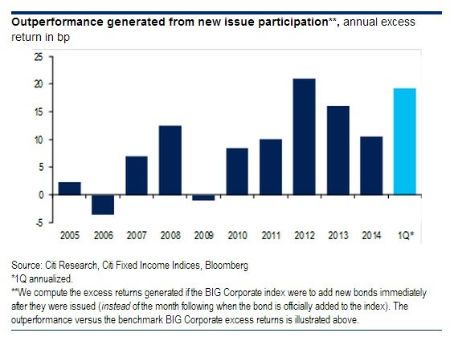
New issue flipping pays
Notes:
Still, inventories are important for the functioning of the market. And it seems that the buy-side has stepped in. On this slide you can see that it is profitable to buy a chunk of new issues and then retail the bonds – a strategy sometime termed “new issue flipping”. This makes the allocations a critical thing (analogously to IPOs in the equity market). The syndicates have a lot of power there. Big players, via reverse enquiries, often get more than their fair share. This raises ethical questions and brings in the regulators. More recently, new-issue spreads have come down a bit.

Slide 85


The secondary market works like a bazar
Notes:
On this slide you see two illustrative screenshots from my Bloomberg terminal. The left chart shows my inbox on the 7-July-2016 16:03. You can see that one page of messages filled within 3 minutes. This is normal – I get hundreds of such messages per day. Messages are sent by investment bank sales persons. They contain «axes», «runs» and «cash updates» – all pricing indications of bond positions they have on the book. When a trader buys a position in a bond (normally from a client of the bank), he will typically tell his sales staff to find an investor who is willing to pick it up; this is normally termed an axe. Sometimes traders also sell bonds without owning them. They can do so by borrowing the bonds in the context of a securities lending program. They can be short the bond as long as the original owner of the bond does not claim it back. Sometimes, they also sell the bond before figuring out where to get it – hoping they can borrow the bond or buy it somewhere before settlement.
To the right you see an example of quotes for a specific bond. Some banks offer both sides of the trade for a specified max amount. These prices are generally not directly executable. For larger amounts, I have to call the sales person and the sales person will talk to the trader sitting right behind him. In an institutional setup, the execution desk will call at least 3 brokers to make a quote. If you do this for illiquid bonds, though, you may destroy your market.

Slide 86




Distinguish 2x2 types of credit risk
Credit loss
Spread risk
Idiosyncratic risk
Systematic risk
Notes:
[Discussion:
How do you define the four types of risk?
To what extent is credit loss systematic and spread risk idiosyncratic?
Which type of credit risk can be diversified?]

Slide 87


Default rates follow the economic cycle
Notes:
This is the first slide on credit loss. Losses occur for two reasons: defaults and «haircuts». Default risk is sometimes quantified as “probability of default” (PD) while the haircut is calles “loss given default” (LGD). Default occurs when the issuer or guarantor is no longer able or willing to make the payments he promised when he issued the bond. Under most bankruptcy laws, default on one security automatically implies default on all securities. On the top panel (S&P data), you see that the default risk for investment-grade rated securities is relatively low (<0.5%), even in periods of stress. Also note how defaults, mainly in sub-investment grade debt peeks in periods of economic downturn. The highest level of defaults occurred in the great depression.
[Discussion: How do you explain that defaults in the great financial crisis were not massively higher than in the recessions of 1991 and 2001?]
More: Edward Altman, Brooks Brady, Andrea Resti, and Andrea Sironi. “The Link between Default and Recovery Rates: Theory, Empirical Evidence, and Implications” in Journal of Business vol. 78, no. 6 (November 2005). Classic paper showing the empirical correlation between PD and LGD.

Slide 88


Defaults and credit losses follow the economic cycle
Defaults
Credit Loss
Source: Moody‘s Annual Default Study Feb 2016
Notes:
When a company defaults, there are basically two options:
The company is liquidated (“gone concern”)
The company reaches out to creditors and owners and negotiates a restructuring of its debt (“going concern”)
In both cases, bond holders are generally able to recover some of the notional (recovery rate; the part lost is sometimes called the “haircut”). In these charts you see how the defaults have translated into credit losses.

Slide 89
Senior bonds have higher recovery rates
Recovery in case of default
60%
Source: Moody‘s
50%
40%
30%
20%
10%
0%
Senior Secured
Senior
Average
Senior
Subordinated
Junior
Unsecured
Subordinated
Subordinated
Notes:
When an issuer defaults on a bond, it automatically triggers default on all bonds (bankruptcy laws ensure that in the case bankruptcy all creditors are treated in line with pari passu). In the workout, however, not all creditors are equal. “Normal” debt is classified as senior unsecured. Senior secured is a bit better: when you buy such a bond, the documentation gives you a claim on specific assets of the issuer (e.g. real estate owned by the company); in the case of bankruptcy, the assets are sold separately to pay down this debt. Consequently, the recovery rate of secured debt is higher. When banks give a loan to a company, they typically request additional securities. That means that in case of bankruptcy, these securities are no longer available for normal senior debt holder. This is called “structural subordination”.
On the right, we have more junior type of debt. Such instruments have clauses which are unfavourable in case of a workout. Of course, the creditors will demand a higher yield for more junior debt. Also, the more junior you get, the closer you move to equity.

Slide 90


Credit losses can be of going concern
Assets
Liabilities
Safe Assets
Risky Assets
Deposits
IN
Senior Debt
T2 Capital
Add.T1 Capital
Equity (CET1)
Notes:
On the preceding slides, we described credit loss as a default / recovery case. Reality is more complicated than that. Take the example of banks. The common thinking before the great financial crises was that equity was there to absorb fluctuations on the asset sides. Once the equity is gone, the bank is gone concern. The distinction between sub and senior would only be in the priority of claims. In the crisis, however, policy makers found out that banks were basically too big to fail. In order to protect depositors and to prevent systemic contagion, they had to bail out everybody –even the sub-debt holders. Zombie-banks survived. One of the conclusions, especially in Europe, was that if they wanted to avoid that the taxpayer had to carry all the downside, they had to create new types of capital that could be bailed-in before the bank collapsed – the banks remain going concern. First, they created explicitly bail-in-able securities called cocos (for contingent convertible securities). These are bonds that convert into equity or are written down if the capital of the bank falls below a certain level. This does not fall under the definition of a credit event (default). Nevertheless, for an investor it feels pretty much like a default. Soon, regulators started to realise that this was probably not enough under bigger stress. So they moved up the whole liability structure. Under new European regulation, even senior debt is subject to bail in. And in Cyprus, even deposits were «taxed» to prevent a collapse of the banking sector.
Conclusions for a bond investor: default is not the only scenario that can trigger loss of capital. This also holds true for corporate bonds where you may suffer a “haircut” under a debt-restructuring scenario.

Slide 91
Ratings agencies produce estimates of default risk
Moody's | S&P | Fitch
AAA | AAA | AAA | Upper Investment Grade
Aa1 | AA+ | AA+
Aa2 | AA | AA
Aa3 | AA- | AA-
A1 | A+ | A+ | Lower Investment Grade
A2 | A | A
A3 | A- | A-
Baa1 | BBB+ | BBB+
Baa2 | BBB | BBB
Baa3 | BBB- | BBB-
Ba1 | BB+ | BB+ | Sub-Investment Grade
Ba2 | BB | BB
Ba3 | BB- | BB-
B1 | B+ | B+
… C | … | …
… | D | D | Distressed
Notes:
Rating agencies are supposed to produce objective assessments of default risk. They attach a rating to issuers and specific bonds. On this slide you see the rating scale of the three «official» rating agencies. The best rating is AAA (which happens to be the ratings of Norway and Zürcher Kantonalbank). Note the important distinction between investment grade and sub-investment grade.

Slide 92

Credit agencies use different acronyms for short-term ratings
Notes:
You may find this table useful. Short-term ratings are used by banks and money market funds.

Slide 93
Ratings do contain information on default risk
Notes:
Long-term studies show that rating agencies do a decent job in predicting default probabilities. Credit losses over a certain time horizon do indeed increase the more you move down the rating dimension. This study was produced by S&Ps a very long data set. Results are similar for other ratings agencies and are quite stable in the long run.

Slide 94

There is a debate about bias in agency ratings
Notes:
In reality, ratings are never fully «objective». In 2014 UniCredit (an Italian bank) published an interesting study. They fitted a probit model with economic indicators (nominal GDP, debt levels, current accounts, past defaults and some transparency indicators) predicting defaults. This resulted in an empirical «objective» rating. They then went on to contrast this with Moody’s ratings and showed that the «subjective» component of the rating committee did not improve the forecast of default probability. Their conclusion then was that credit committees were biased (an anglo-saxon conspiracy against Italy?) and did not add value.
More Info
http://ftalphaville.ft.com/2014/03/27/1813352/sovereign-rating-bias-a-clanging-gauntlet-lands/
http://www.dt.tesoro.it/export/sites/sitodt/modules/documenti_en/analisi_progammazione/brown_bag/GlobalThemesSeries_26Mar14.pdf

Slide 95

Ratings are also made in China
Notes:
Ratings have a strong political impact. Therefore, many contries complain about the US dominance in the sector. China has its own rating agency (Dagong).
[Discussion: Do you think that the relative ratings of China, Japan and the US is justified? Why?]
Details: http://en.dagongcredit.com/ratingAnnouncement/countryList_4.html
Other new rating agency focusing on Germany and Europe: www.scoperatings.com in particular https://www.scoperatings.com/study/download?id=7a28cff8-698c-473e-bcc8-80f759d9f10c&q=1

Slide 96
Company ratings reflect business risks and leverage
FFO/debt | >60% | 45-60% | 30-45% | 20-30% | 12-20% | <12%
Debt/EBITDA | <1.5x | 1.5-2x | 2-3x | 3-4x | 4-5x | >5x
Debt/Capital | <25% | 25-35% | 35-45% | 45-50% | 50-60% | >60%
Financial Business | Minimal | Modest | Inter-mediate | Significant | Aggressive | Highly Leveraged
Excellent | AAA | AA | A | A- | BBB | -
Strong | AA | A | A- | BBB | BB | BB-
Satisfactory | A | BBB+ | BBB | BB+ | BB- | B+
Fair |  | BBB- | BB+ | BB | BB- | B
Weak |  |  | BB | BB- | B+ | B-
Vulnerable |  |  |  | B+ | B | CCC+
Source: S&P
Notes:
Company ratings also reflect a combination of objective criteria and more qualitative assessments. Here the example of S&P which can serve as a rough guide. On the top you see three types of indicators (cash generation, debt in comparison to earnings and debt as a share of assets) that are combined in a quasi-objective assessment of financial risk / leverage. The business risk is more fuzzy. The quality of management, the competitive position (think of Porter), industry trends, country related risk …. – all you can think of can influence business risk.
Rating agencies are often criticised because their rating process is to slow or flawed for other reason (e.g. companies paying for their rating). Some portfolio managers try to add value by doing a better job than the agencies. This is a bottom-up approach generally called “fundamental analysis”. There are two basic flavours
“primary research”: Do the whole work of the rating agencies from scratch. This includes reading the whole documentation and develop detailed forecasts of earnings and cash flows. A good primary analyst spends a lot of time on adjusting income statements and balance sheets to read through the accounting gimmicks and get a clear economic picture of the company.
“secondary research”: Use the work of the rating agencies and other primary research providers and focus on the big picture of the company. Such analysis tends to be more qualitative. Secondary analysis is sometimes described as the four C: character (business model and quality of strategy and management), capacity (do they generate the funds to pay back debt?), collateral (what tangible assets are there to monetize) and covenants (any small print that allows equity holders to screw bond holders).
Large asset managers employ armies of credit analysts to do primary or secondary research. There is no consensus if this really does add value.

Slide 97

Investors should care more about covenants
Taken from Deutsche Bank
Notes:
Credit analysis has a tendency to overlook covenants. This has become obvious over the last couple of years. In the chart on the slide you can see the evolution of an S&P index of covenant quality. Many investors have started to move from bonds into loans – partly because, historically, loans had strong covenants (think of banks imposing strict conditions on the loans they issued; historical recovery rates of loans were typically 30 percentage points higher than those of bonds). As the balance between demand and supply has shifted, credit officers approving the loans more and more had to close their eyes. Keep in mind that ratings only focus on default probabilities and less on recovery.

Slide 98


Mind the gap between IG and HY
Notes:
You may find this slide confusing? Here is the story: Many institutions (think of insurance companies) are restricted to buy investment-grade bonds. So, when a bond falls out of investment grade due to a rating change, they have to sell. This is called «forced selling» or «fire sales». As the volume of investors restricted to investment grade tends to be larger than the investors going for high yield, the market re-prices sharply before a new equilibrium is reached. However, before a rating agency downgrades a company to junk, they typically put the company on «review for downgrade». As a consequence, the re-pricing takes place before the actual downgrade. This leads to the a V-shaped performance (under perform before the downgrade; stabilise after the downgrade). You see this picture in the left-hand chart. The phenomenon has been around for some time and in the aftermath of the great financial crisis, people started to play the story even with dedicated fallen angel products.
More recently, the effect seems to have vanished. You can see this on the light blue line in the chart on the left. The common explanation for this is that more and more people chase yield in high yield. From time to time, however, the story still works. 2016 was a good year for people betting on the recovery of fallen angels (that’s the data in the chart on the right). The reasons are unclear but I think that they have more to do with the risk-reversal of systematic factors (notably emerging markets) than the recovery of idiosyncratic downgrades. Anyhow, predicting ratings actions of the agencies has become an important secondary research skill.

Slide 99


CDS work like an insurance
Protection Buyer
premium
settle bond at par in case of credit event
Protection Seller
Note: taken from pimco.co.uk
Derivatives are financial weapons of mass destruction.
Warren Buffet: Letter to shareholders 2003
Notes:
Credit default swaps (CDS) provide an alternative to buying and selling corporate bonds. They basically work like an insurance: if you «buy protection» you pay a periodic premium; in exchange, the protection seller will absorb all the losses in a credit event – like an insurance company absorbs the loss when your house burns down. Credit events include outright default as well as some other events that have similar economic consequences. There is a committee at ISDA that declares credit events. Sometimes, debt is restructured without triggering a credit event. In the past, in a credit event, the protection buyer had the right to sell an eligible bond or loan to the protection seller at par; now CDS are settled all in cash.
In a portfolio context, CDS have some advantages: less invested capital, separation of credit and rates exposure, exposure to credit not available the base currency, sometimes higher liquidity. We regularly use CDS both for reducing risk (buy protection on names in a portfolio, thereby giving up some of the spread we earn on our bonds) or for leveraging up the credit exposure (sell protection on a few names, earning an additional premium). Still, not everybody is a fan. When Warren Buffet warned in 2003 that financial derivatives are weapons of mass destruction, he thought of CDS. He was concerned about the gigantic notional, the concentration in the hands of a few traders and the spillover risk resulting from the counterparty risk associated with OTC instruments. It turned out that he was right. As a lesson of the great financial crisis, regulators have addressed many of these issues (standardisation, central clearing, reporting and risk mitigation). Some concerns remain, though. Most importantly, CDS may add fire to already explosive situations. For example, the EU did forbid the use of CDS to speculate on a default of Greece.
More:
http://www.ft.com/cms/s/0/1c81fdf8-d4b9-11e0-a7ac-00144feab49a.html#axzz4H1jKhJUR. An interesting (albeit somewhat dated) article in the FT on the topic
Marti Subrahmanyam, Dragon Tang and Sarah Qian Wang. “Does the Tail Wag the Dog? The Effect of CDS on Credit Risk”, 2015. The paper shows that CDS trading can increase default risk.

Slide 100

Good news: denuclearization
Notes:
Two observations
Volume of CDS is shrinking since 2008 because maturing contracts are not renewed.
Trend is more pronounced for single-name CDS.
On top of this: new regulation force OTC brokers to centrally clear OTC contracts. Netting agreements and collateralization further reduce risks.

Slide 101
Expected credit loss does not (fully) explain the level of spreads
Default rate
Recovery rate
5-year
annualized
0%
5%
10%
15%
20%
25%
30%
35%
40%
45%
50%
55%
60%
65%
70%
75%
80%
85%
90%
95%
100%
0.0%
0.0%
0
0
0
0
0
0
0
0
0
0
0
0
0
0
0
0
0
0
0
0
0
0.5%
0.1%
10
10
9
9
8
8
7
7
6
6
5
5
4
4
3
3
2
2
1
1
0
1.0%
0.2%
20
19
18
17
16
15
14
13
12
11
10
9
8
7
6
5
4
3
2
1
0
1.5%
0.3%
30
29
27
26
24
23
21
20
18
17
15
14
12
11
9
8
6
5
3
2
0
2.0%
0.4%
40
38
36
34
32
30
28
26
24
22
20
18
16
14
12
10
8
6
4
2
0
2.5%
0.5%
51
48
46
43
41
38
36
33
30
28
25
23
20
18
15
13
10
8
5
3
0
3.0%
0.6%
61
58
55
52
49
46
43
40
37
34
31
27
24
21
18
15
12
9
6
3
0
3.5%
0.7%
72
68
64
61
57
54
50
46
43
39
36
32
29
25
21
18
14
11
7
4
0
4.0%
0.8%
82
78
74
70
66
61
57
53
49
45
41
37
33
29
25
20
16
12
8
4
0
4.5%
0.9%
93
88
83
79
74
69
65
60
56
51
46
42
37
32
28
23
19
14
9
5
0
5.0%
1.0%
103
98
93
88
82
77
72
67
62
57
52
46
41
36
31
26
21
15
10
5
0
5.5%
1.1%
114
108
102
97
91
85
80
74
68
63
57
51
46
40
34
28
23
17
11
6
0
6.0%
1.2%
125
118
112
106
100
93
87
81
75
68
62
56
50
44
37
31
25
19
12
6
0
6.5%
1.3%
135
129
122
115
108
101
95
88
81
74
68
61
54
47
41
34
27
20
14
7
0
7.0%
1.4%
146
139
132
124
117
110
102
95
88
80
73
66
58
51
44
37
29
22
15
7
0
7.5%
1.5%
157
149
141
134
126
118
110
102
94
86
79
71
63
55
47
39
31
24
16
8
0
8.0%
1.7%
168
160
151
143
135
126
118
109
101
92
84
76
67
59
50
42
34
25
17
8
0
8.5%
1.8%
179
170
161
152
143
134
125
117
108
99
90
81
72
63
54
45
36
27
18
9
0
9.0%
1.9%
190
181
171
162
152
143
133
124
114
105
95
86
76
67
57
48
38
29
19
10
0
9.5%
2.0%
202
192
181
171
161
151
141
131
121
111
101
91
81
71
60
50
40
30
20
10
0
10.0%
2.1%
213
202
192
181
170
160
149
138
128
117
106
96
85
75
64
53
43
32
21
11
0
10.5%
2.2%
224
213
202
191
179
168
157
146
135
123
112
101
90
79
67
56
45
34
22
11
0
11.0%
2.3%
236
224
212
200
189
177
165
153
141
130
118
106
94
83
71
59
47
35
24
12
0
11.5%
2.4%
247
235
223
210
198
186
173
161
148
136
124
111
99
87
74
62
49
37
25
12
0
12.0%
2.5%
259
246
233
220
207
194
181
168
155
142
129
117
104
91
78
65
52
39
26
13
0
12.5%
2.6%
271
257
244
230
217
203
189
176
162
149
135
122
108
95
81
68
54
41
27
14
0
13.0%
2.7%
282
268
254
240
226
212
198
184
169
155
141
127
113
99
85
71
56
42
28
14
0
13.5%
2.9%
294
280
265
250
235
221
206
191
177
162
147
132
118
103
88
74
59
44
29
15
0
14.0%
3.0%
306
291
276
260
245
230
214
199
184
168
153
138
122
107
92
77
61
46
31
15
0
14.5%
3.1%
318
302
286
271
255
239
223
207
191
175
159
143
127
111
95
80
64
48
32
16
0
15.0%
3.2%
330
314
297
281
264
248
231
215
198
182
165
149
132
116
99
83
66
50
33
17
0
Notes:
This table shows the spread needed to compensate for credit losses – simple probability calculations. I have shown above that default rates in investment grade bonds are significantly below 0.5% p.a. BBB-rated bonds have cumulative 5-year default probabilities of roughly 2-3%. If we assume the long-term average recovery rate for senior debt of 40%, we can read off a required rock-bottom spread of 24-37 bps. If BBB-rated bonds had these spread, the additional return would offset the long-run expected loss from defaults. However, we have also seen that actual BBB-spreads tend to fluctuate in a range of 100-300 bps over «credit-risk-free» Treasuries. Free lunches are never for free. Obviously, there is another risk you are being compensated for.

Slide 102
Credit spreads fluctuate heavily
Spread of BBB-rated USD bonds over US Treasuries
800
700
600
500
400
300
200
100
0
Jan 25
Aug 28
Apr 32
Dec 35
Jul 39
Mar 43
Nov 46
Jun 50
Feb 54
Oct 57
Jun 61
Jan 65
Sep 68
May 72
Dec 75
Aug 79
Apr 83
Nov 86
Jul 90
Mar 94
Oct 97
Jun 01
Feb 05
Source: Datastream
Source: Barcap Live
Notes:
I had to glue two charts together in order to get an almost 100y history of BBB-spreads versus US Treasuries. While the quality of the long history may be doubtful, the picture is clear: Most of the time, BBB-spreads fluctuate somewhere between 100-300 bps. We have seen two episodes to the upside (the great depression between WWI an WWII and the great financial crisis of 2008) and the Golden 50s and 60s with lower spreads. We also see that the peeks do not always coincide with recessions.

Slide 103

Today, iTraxx tells the mood of the market
Notes:
Average spreads of credit indices are one way to look at the average level of spreads. Practicioners would more look at CDS indices. In Europe, the most used index is the iTraxx index by Markit. This index is basically a basket of 125 CDS on the most liquid credits. There are also some subindices, for example a crossover index.
Note the most recent development of the spread level. Interestingly, spreads widened despite a booming stock market. How would you explain this?

Slide 104
Credit spreads are a source of return and volatility
Credit spread
Risk-free (nominal) rate
t
Notes:
This chart shows credit spreads in the framework we used in preceding chapters. We start with the current investment PV growing at the risk-free nominal rate until maturity, resulting in a CF. If we add an element of credit spreads, we obtain higher CFs. At the same time, the discount becomes steeper. Once we invest in a credit bond, this additional element becomes a source of volatility. If credit spreads for the specific bond falls, the discount becomes flatter and the PV increases. The opposite holds true for rising credit spreads. Through the lever of (credit) duration, volatility in the market price of credit risk translates into volatility of bond prices.

Slide 105
Fixed Income has become a credit play
-3
3
Variance of weekly x 10
2.5
2
Credit
1.5
1
Risk-free nominal rates
0.5
Total risk
1974
1976
1978
1980
1982
1984
1986
1988
1990
1992
1994
1996
1998
2000
2002
2004
2006
2008
2010
Notes:
The contribution of rates and credit to the total volatility of a fixed income portfolio depends on the market segment. The composition also changes over time. In this chart I decompose the volatility of a very broad index (the Barcap Global Agg you’ve seen in the introduction) into credit and rates components. Compare the two peek in vol of the 1980s with the great financial crisis. While the volatility of the 80s was almost entirely driven by rates vol (remember the long-term charts on yields), the great financial crisis saw a huge surge in the volatility of credit spreads. Also note that the credit component had a strongly diversifying effect on the total risk. When the market is in «risk-off» («risk-on») mode, credit spreads widen (tighten) and risk-free rates fall (rise).
However, looking forward this may change again if some day inflation picks up.

Slide 106

Duration may serve as hedge for credit risk
Notes:
Having said that the mix of risk has changed, this does not mean that the two are uncorrellated. In 2016, duration was actually a hedge for credit spread vol. However, this did not work in 2018. Any idea why?

Slide 107
Merton said: long credit = short put on the stock
Spread over swap Glencore 4 1/8 23 (Jan ‘15 to Jun ‘16)
1200
1000
800
600
400
200
0
100
200
300
400
500
Share price Glencore (in USD)
Notes:
Almost 50 years ago, Robert Merton proposed a structural model establishing a link between the equity and credit markets. The basic idea is simple: Equity holders own the net assets (assets – liabilities) of a company. If you take liabilities for granted, the value of equity will be subject to the volatility of the value of assets. If net assets fall below zero, your company is bust and will not be able to pay off the creditors. From the point of view of the equity holder this is a long put option at/below zero equity. As with all options, there is always a time value (even if the equity is currently negative, it may recover). So equity holders will run even a negative-equity business as long as the company has cash.
Creditors write (are short) the put. As long as the company is going concern, they earn the option premium but they may lose part of the capital if the option is exercised. From the bond holder perspective, the (negative) put value has the typical shape of a hockey stick. This translates into convex relationship between the stock price and credit spreads. Here you see the data for Glencore, a company active in mining and commodities trading. This company was getting close to negative equity towards the end of 2015. You can observe how the delta increases when the stock price falls.
Companies like KMV (now purchased and distributed as «Credit Edge» by Moody’s) and Credit Suisse (CUSP) have been pioneers in selling Merton-type model (data and analytics) to asset managers. They still use them to a) determine relative value (is the spread consistent with the put option value) and b) as early warning signals (changes in the stock price and volatility could precede a spread widening).
Recommended reading:
Suresh Sundaresan, «A Review of Merton’s Model of the Firm’s Capital Structure with its Wide Applications», in Annual Review of Financial Economics 2013.
Robert Merton, «On the Pricing of Corporate Debt: The Risk Structure of Interest Rates», Journal of Finance 1974.

Slide 108

Liquidity is the elephant in the credit room
Notes:
Here you have some indications what could happen when the music stops. The chart shows the market share of passive high yield ETV in trade volume. Traditionally, the high yield market is a playing ground of long-term investors. Institutional investors should be able to hold on to their positions also during rough times. ETF, on the other hand, provide continuous liquidity in this intrinsically illiquid market. When the tide turns, high yield ETF trigger the bulk of trades, thereby amplifying price fluctuations. Maybe we have to start worrying about ETF replacing CDS as the prime weapon of mass destruction.

Slide 109
From bank credit, to securitzation to private debt
Notes:
Before we conclude this chapter on credit, let’s mention that the corporate bond market has probably peaked. Low yields have pushed many institutional investors into more illiquid asset classes like loans. On the supply side, banking regulation has forced many banks, especially in Europe, to offload assets from their balance sheets. While similar trends created the ABS boom in the late 90s early zeros, investors pick up the assets through CLO or directly via private debt funds. In fact, private debt has been an extremely fast-growing asset class over the last few years. Even private equity giant have started to focus more on private debt than private equity.

Slide 110

Loan market is exploding
of 3-Oct-2018
Notes:
US loan market (sometimes referred to as «leveraged loans») are the biggest segment of private debt. 1tn is a lot of money for such an illiquid asset class.

Slide 111

Fixed income products are about to replace banks
Quelle: Funding Circle Juni 2018
UK Finance Bank Support for SMEs – 4th Quarter 2017; Funding Circle
UK Finance definition of a small business: SMEs which typically fall within banks' 'business-banking' operations and have less than £2m annual debit turnover
Financial Times (https://www.ft.com/content/3a1c5cbc-f088-11e3-8f3d-00144feabdc0)
https://ec.europa.eu/commission/sites/beta-political/files/juncker-political-guidelines-speech_en_0.pdf
Business Insider (http://uk.businessinsider.com/funding-circle-raises-100-million-accel-chancellor-philip-hammond-fintech-2017-1)
Notes:
A new emerging trend is credit via peer-to-peer platforms. If we go back to our very first slide, the «bond market» is replaced by an internet site that brings credit takers directly together with investors. This has a lot of implications. For banks, it’s a major threat to their business model by Fintech companies. Possible, the bond market will look very different in a few years…
Note that banks tried to offload assets from their balance sheets in the past. Last times it was through securization – ABS and MBS. This was probably one of the ingredients of the 2008 financial crisis. You can find similarities in the fintech lending industry.

Slide 112

Less money for the financial sector
Notes:
This slide demonstrates how online lending can beat the high cost base of a bank. More generally, there is a reason why investment banks, bonds syndicates, bond sales, fixed-income trades …. receive substantial bonuses. And these reasons are about to change. Think twice before you decide for a career in the industry!

Slide 113
6
Managing global fixed income
Notes:
Global portfolios are in many ways superior to single-currency portfolios. They improve diversification and add additional sources of alpha. If you go abroad, you need to think about global correlation in yields and foreign exchange.
After this section you should be able to
Make qualified statements about the advantages and disadvantages of fx hedging.
Set up a perfect hedge.
Understand the issues related to average yield figures.

Slide 114







Expected fx changes offsets any interest-rate differential
Covered Interest-Rate Parity
E$\left[y_{F,h}^{}\right] =$ $y_{f}^{}$+ E$∆\left[\frac{h}{f}\right]$
F$∆\left[\frac{h}{f}\right]=y_{h}^{}−y_{f}^{}$
Efficient Expectations
E$∆\left[\frac{h}{f}\right]=\text{F}∆\left[\frac{h}{f}\right]$
$=$ $y_{f}^{}$+ F$∆\left[\frac{h}{f}\right]$
Fisher-Equation
$$y=r+π$$
$=$ $y_{h}^{}$
Purchasing Power Parity
E$∆\left[\frac{h}{f}\right]=π_{h}^{}−π_{f}^{}$
Notes:
I assume that you have seen the stuff on this slide; it shows (covered) interest rate parity, the Fisher Equation and Purchasing Power Parity. In the context of fixed income portfolios, the key take-aways of these macro-economic statements are as follows:
Forward contracts reflect the difference in interest rates
Drifts in currencies are mainly driven by inflation-differentials
By hedging, you iron out the drift and equalize interest rates

Slide 115
In the long run, we are all dead ….
2-year rolling returns
Cash EUR/DM
Cash EUR in CHF
Cash CHF
Notes:
Here you can see that the punchline of the previous graph is true in the long run. The graph compares the returns of cash in CHF and EUR, both on a fx-hedged and non-hedged basis. You can see that until the introduction of the EUR in 1999, the DM yielded a higher cash return in local currency but the currency depreciation has almost exactly offset the interest rate differential. After the introduction of the EUR, the currency movement has become more erratic. At first sight, it seemed that you could earn a «free lunch» additional return in EUR. But then, the currency depreciation brought back (from a CHF perspective) the EUR investment to the local currency cash return. The Swiss national bank then tried to peg the currency to the «fair value» but had to lift the peg in 2015.
The flipside of this view could be observed in Hungary and Poland (and also Austria). Many home-owners took mortgages in CHF because the interest-rate differential looked attractive. When the currency started to fall, many households were no longer able to pay their debt. Had they only studied the formulas on the previous slide!

Slide 116
… but fx matters in the meantime.
2-year rolling returns
Notes:
While PPP holds in the long run, it does not so in the short run. On this slide you see more recent data comparing Norwegian government bonds to a global index. Two important observations:
In NOK, the unhedged index shows large fluctuations. By hedging, you iron out a lot of volatility. So, while fx exposure does not add (or subtract) performance in the long run, it adds short-term risk.
The performance of Norwegian government bonds closely matches the swings in the performance of the global index on a hedged basis. It seems that interest rates (or, more precisely, unexpected shifts in interest rates) follow global patterns. So, diversification of yield curves is a relatively weak argument for investing in foreign currency.

Slide 117
FX forwards exchange two zero bonds
NOK
Spot
Forward
USD
Notes:
So, let’s have a look at practical fx hedging.
On this slide we start with the graphical representation of the forward (turquoise). At the settlement date of the contract, we exchange payments in two currencies. The relative size of the two cash flows is given by the forward rate.
Each cash flows has a specific present value. This can be found by discounting each cash flow. Alternatively, we can express the CF as compounded PV.
Consequently, the forward is the ratio of compounded PV. Finally, noting that the spot is the ratio of the two PV, we can see that the forward is simply the spot multiplied by the (inverse) ratio of the discount factors.

Slide 118
How to put in place a perfect hedge
NOK
Spot
USD
Notes:
Here you see how to use fx forwards to hedge any fx risk in a foreign currency portfolio.
Start with a bond (light blue). That bond is in a foreign currency – USD.
This bond has a current market value (dark blue positive).
The Spot rate defines the value of the investment in your home currency. Note that if the spot rate changes, the value of the bond remains constant in foreign currency terms, but changes in your home currency.
Now add a forward. The notional will be such that the CF of the forward ensures that its PV exactly offsets the PV of the bond.
You now have two PV on the foreign currency side that cancel each other out. Consequently, the spot rate has no impact on the value of the portfolio in your home currency. This holds true for any shift in fx, as long as the two PV in foreign currency exactly match; if the price of the bond changes due to interest rate changes, the hedge will no longer be perfect.

Slide 119

Don’t forget P&L
NOK
USD
Notes:
People who do fx hedging for the first time often get confused when the hedge has to be rolled. On this slide, I try to show the basic principle. Start with the slide above. For simplicity, we take out PV form the chart. We end up with the CFs: the coupons and capital of the bond and the two zero coupon bonds of the forward. Now, let’s again move forward in time to the settlement date of the forward. At that date, the two zero bonds mature. You will get a positive cash flow in home currency and a negative cash flow in foreign currency. If you hold cash in foreign currency, this will simply be deducted from your balance but chances are high that your account falls below zero and your bank gives you a call. In order to settle the balance, you have to cover your forward by buying foreign currency in the spot market. If you do so, however, your portfolio will no longer be hedged. You therefore also need to sell foreign currency in the forward market.
These two transactions (spot and forward) are done in one go as a currency swap. The important point to keep in mind is that the forward leg of this swap is fixed using the same spot rate. The only difference is again the ratio of the discount rates – reflecting the interest rate differential between the two currencies. This is typically expressed as «forward points». As the spot rate is appearing twice (on the cover and the new forward), its level is cancelled out. Only the forward points matter [a more precise statement will follow].

Slide 120

Spot the forward point
Notes:
Here you see how forward points are quoted in practice. I’ve taken the slide 13-Jun-16. The settlement period of spots is 2 days, so we have the spot settling 15-Jun-16. Note how the forward points increase with longer settlement periods. The forward points (i.e. /10’000) are then added to the corresponding bid or ask spot rate.
When you do an fx swap, the trader will just propose the points; once you agree on the points, the spot rate has no importance.

Slide 121
Forward points are more than interest-rate differentials
NOK/EUR
CHF/EUR
Fwd points
Fwd points
Libor/Nibor diff
Diff Libor rates
Source: Bloomberg/own calculations
Notes:
Forward points can be approximated by taking the differences in Libor rates. However, the fx forward market is an independent market and does not necessarily clear exactly at the rate suggested by Libor. The reason for this is that funding costs (spreads vs Libor) vary across currencies. In normal market conditions, these spreads are small. In Stress periods, however, the forward points can deviate quite substantially from the differences in Libor. This means that in a crisis, hedging can become massively more expensive. Better to hedge before the crisis hits.
More: Tomoyuki Iida, Takeshi Kimura, “Regulatory Reforms and the Dollar Funding of Global Banks: Evidence from the Impact of Monetary Policy Divergence”, Bank of Japan Working Paper, August 2016. This paper derives a model explaining deviations from covered interest rate parity (the difference between the two lines in our chart). They find that banking regulation has an important impact.

Slide 122

Basis-spreads reflect cost of funding
Notes:
On the preceding slide I’ve shown you that the forward points sometimes substantially deviate from the interest-rate differential. The spread is driven by a strange beast called the «basis spread». The basis arises because there is always a difference across currencies in the ratio of funding needs (demand of funding) to available capital (supply of funding). Basis spreads can be derived from cross-currency swaps. They have a term structure like normal yield curves.
Companies try to take advantage of the basis-spread curves. For example, take a company that has a funding need in DKK. This company can issue debt directly in DKK. Suppose the company has a high rating and trades flat to the swap curve. So, the cost of funding in DKK would be swap +0. Now, suppose that the treasurer has another idea: He could issue debt in USD and swap the cash flows back into DKK. There can be good reasons for this. For example, Russian companies used to issue CHF denominated bonds because a lot of rich Russians hat CHF denominated accounts managed by Swiss banks. For the Danes, issuing in USD, expressed in USD may be more costly. Nobody in the US knows the Danish company, so they would ask additional compensation. Assume the company can issue 5-year bonds at swap+50 bps. The pleasant surprise then, comes in the swap. Due to the basis, the swap contains a discount of 70bps. On a net basis, the funding is 20bps cheaper in USD despite of the exotic-issuer penalty. Situations like the current one for DKK are rare. Still, a good treasurer will use international debt markets to minimise cost of funding.

Slide 123
Hedges generate realised and non-realised P&L
NOK
USD
Notes:
Once a hedge is put in place, value of the forward will fluctuate with the exchange rate. If we just look at the forward (ignoring the investment in the bonds), we see two zero bonds. The local currency CF is not dependent of the exchange rate. On the other hand, the value of the foreign exchange CF moves up and down with the exchange rate. Hence the net value of the forward absorbs the corresponding volatility, in terms of local currency, of the bonds. As long as the forwards do not settle, this profit or loss is only in the valuation and has no impact on your account. It’s referred to as “non-realised” P&L.
The situation changes when the forward settles. Suppose the foreign currency depreciates. You then need less local currency to cover the short of the account. The net cash (the amount you get from the forward minus the cash needed to cover the short on your foreign currency account) is your realized profit. You can then make an even swap (buy zeros with the same PV as your CF) and use the additional cash to buy some more bonds. One way to see this: The value of your bonds, expressed in local currency, has decreased. But as you have hedged your position, the loss is offset by a profit from your fx forward. This profit is reinvested. In the end, the value of your bonds remains unchanged by the exchange rate movement.

Slide 124
«Average Yield» is a meaningless concept
 | Formula | Average Yield
Simple average |  | 4.000%
Duration-weighted |  | 4.777%
IRR |  | 4.782%
Bond 1
Bond 2
Nominal
1‘000‘000
1‘000‘000
Maturity
1 year
10 years
Coupon
3%
5%
Yield
3%
5%
Duration
0.97
7.72
Notes:
Professional bond managers rarely talk about yields. This may sound surprising. But there is a good reason for it: in a portfolio context, the idea of average yield is pretty meaningless. Just consider the example on this slide: What would be the average yield of a portfolio consisting of the two bonds mentioned (a 1-year and a 10-year bond)? It turns out that there are several methods to calculate the average yield and that the result differ substantially. Apart from the confusion that this may create, there is a more fundamental question, namely that the meaning of “average yield” itself is unclear. For a single bond, the yield refers to a internal rate of return of a cash flow stream ending at maturity. A portfolio, however, has no clear end date. Once you start to think about re-investing coupons and capital, the whole idea of average yield starts to become fuzzy.

Slide 125

Average yields become even fuzzier in international portfolios
Notes:
Despite of the confusion around average yields, practitioners – in particular fund selectors – do use the term. Suppose you are invested in foreign-currency bonds. What would be the yield in your home currency? The most common practice is shown on this slide. You see the foreign currency yield curve on the top. If you hedge the full exposure, you can still calculate an average yield considering that the fx forward represents two zero bonds. This works with the simple average formula shown above.
[Disussion: How does this change when we do not hedge fx exposure? How accurate is the method is the foreign currency yield curve has a different slope than the local currency yield curve?]

Slide 126
Duration has no clear meaning in multi-currency portfolios
Notes:
In a global fixed income portfolio, the meaning of duration changes. It now tells us: “By how much changes the value of the portfolio, if all relevant yield curves more at the same time by one unit?”
Of course, yield curves do not move in perfect sync. The four scatterplots show plot monthly changes in 10-year government bond yields in the US, Japan (JP), Germany (DE), Switzerland (CH) and Norway (NO) for the last 20 years. You can see that there is quite a strong - but far from perfect - correlation within European markets as well as between Europe and the US. On the other hand, Japan is quite detached. Also, betas are sometimes significantly different from 1.
Practitioners have found various ways to deal with this. Some adjust the duration contribution for each market with an empirical beta to obtain an aggregate duration. Others do not care about aggregate duration but focus on the duration contribution (duration x weight) of each market.

Slide 127
X
Appendix
Notes:
So far, we have focused on what’s going on in the portfolio. Let’s conclude with a brief chapter on an aspect that makes the life of portfolio managers difficult: risk management.
After this section you should be able to
Put risk management in context with regulation and fiduciary management.
Understand the basic approaches to risk methodologies used for fixed income.

Slide 128
X
Some ideas for empirical research
Applications of Fama-Bliss / Cochrane-Piazzesi frameworks (other currencies, credit, segments of the curve)
Effect of financial repression on the bond risk premium
Shifts in the beta of inflation expectations
Predictive power of implied vol on credit returns and spread levels
Determinants of new issue spreads
Impact of banking capital regulation (capital requirements, cost of capital, value at risk models) on secondary market liquidity and basis spreads
Integration of dynamic macro risk factors in credit risk models
Basis swaps as predictors of credit risk and rating changes
Factors explaining the estimated bias in agency ratings
Impact of EM reserve accumulation/reduction on global fixed income markets
Testing factor-investing in rates and credit (notably momentum strategies; value investing in credit)
Relationship between (low) real rates and risk seeking behaviour of investors (yield chasing)
Factors explaining relative performance after downgrades (fallen angels)
Machine learning in rates and credit
Notes:
You need a topic for your master thesis? Here is a list of ideas. Don’t forget to send me a copy of your wok!

Slide 129



X
Good portfolio managers are hungry
Source: Chuprinin and Sosyura 2016
Notes:
Here another bonus topic. Quite interesting results of a study published this year. Rich portfoliomanagers are no good – in particular MBAs.
Details: Oleg Chuprinin and Denis Sosyura, Family Descent as a Signal of Managerial Quality: Evidence from Mutual Funds, May 2016. Published on the SSRN website.

Slide 130

X
Even more on bonds

